Slide 1
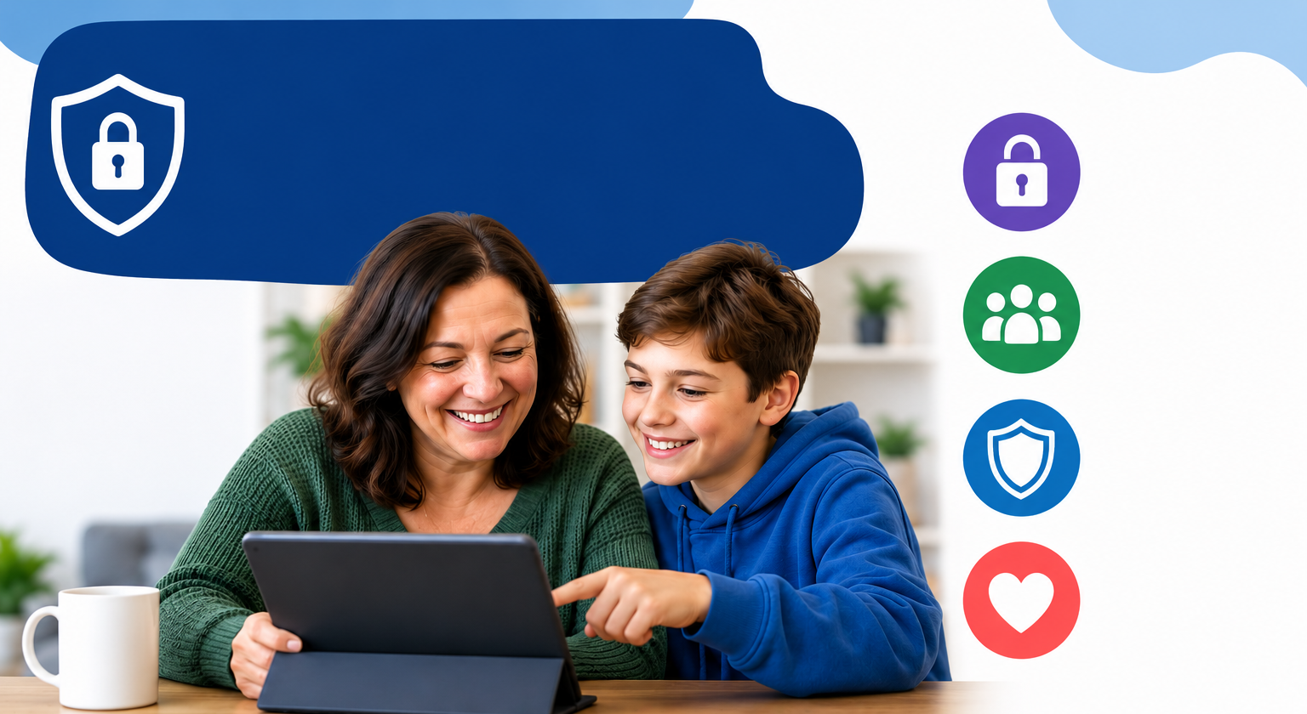





PARENT ONLINE SAFETY
Ready to use Presentation for
Schools, Community Groups and Youth Centres
NEW for 2026
Notes:
This presentation brings together:
- the latest research and key findings on children’s and young people’s online use and risk
parents’ views about their children’s media use, devices and supervision to monitor or limit use
suggested resources and tips to empower parents to keep up with the latest trends/apps and games, manage controls and settings, and talk to children about risk - from bullying and sharing content, to extremism and gangs
Please read the Introduction section before delivering any content to parents

Slide 2
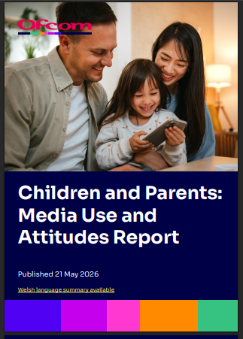

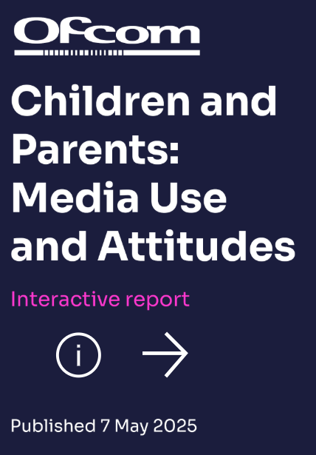
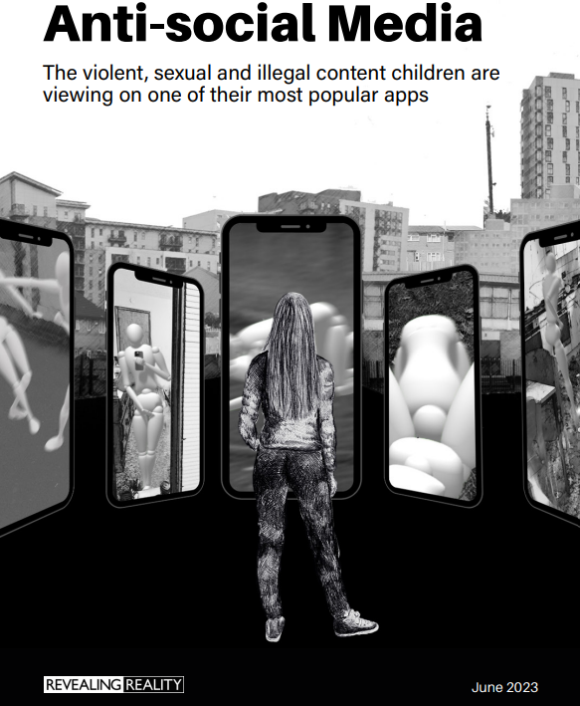


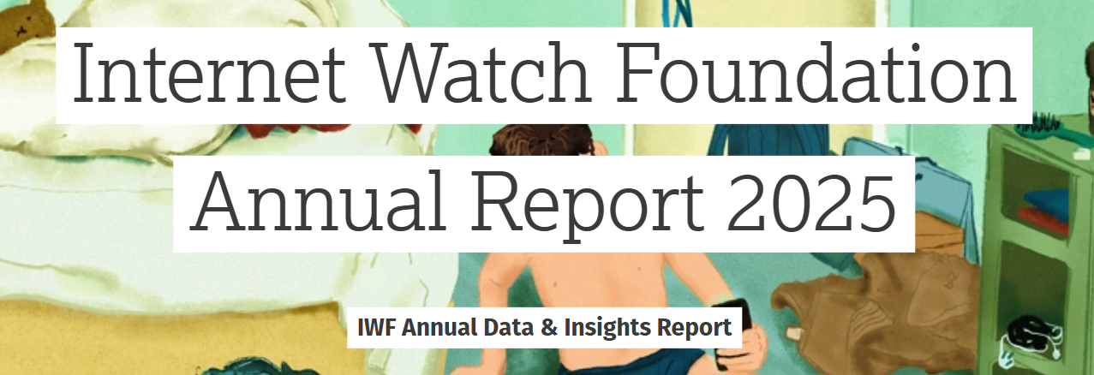
This presentation brings together:
Key Findings from:
  Children and parents: Media Use and Attitudes report
  Children and parents: media use and attitudes report 2026– interactive data
  https://www.internetmatters.org/hub/research/me-myself-and-ai-chatbot-research/
  https://www.iwf.org.uk/annual-data-insights-report-2025
  https://www.gambleaware.org/media/hbcp3qgd/exploring-the-lived-experience-and-views-of-gambling-among-children-and-young-people_final_0.pdf
  Children’s Online User Ages 2025 Quantitative Research Study
  NSPCC (2026) The impact of harmful online content on children
  NSPCC (2024) Young people’s experiences of online sexual extortion or ‘sextortion’
  Evidence on pornography’s influence on harmful sexual behaviour among children Report 2023
  Revealing-Reality Anti-social Media Report 2023
Suggested Resources and Tips for Staff to help Parents/Carers:
  keep up with the latest trends, apps and games
  manage controls and settings
  talk to children about risk

Slide 3

Practitioner Guidance:
When it comes to online safeguarding, we recommend:
a drip-feed approach – e.g. monthly newsletters with a dedicated ‘top online safety tip’, parent letters
incorporating online safety into other events where parents are present, rather than a single standalone session e.g. coffee mornings, parent evenings & celebration days
encouraging your pupils to present with you – why not tap into their knowledge of the latest trends, ask them to share their experiences or demonstrate how to set privacy settings and controls on devices
Before you begin:
We would not expect you to cover ALL of these slides in a single session - decide which topics to cover.
Feel free to amend the presentation - add/remove slides at your discretion to make sessions relevant.
You may wish to use a trigger warning depending on the topics you cover – see next slide.
Ensure you are familiar and confident with the content.
Refer to the practitioner notes in the notes section of each slide to support discussions.
Use these Questions Prompts on the slides to promote interaction.
Avoid being judgemental of parents, and instead offer information, empathy and support.
Notes:
To support your drip-feed approach, visit:
https://safepolicies.lgfl.net/ - download LGfL’s free template letters to inform parents about key topics, e.g. getting a child’s first mobile phone or he risks associated with AI, and your school’s approach to protecting children from these
parentsafe.lgfl.net - top tips / ideas to reinforce key safety messages for you to include in your newsletters and signpost parents to at your online safety events
Parents have almost an impossible task of trying to stay up to date with children’s technology use and the risks associated with it. Each family’s context is different, and technology will have different meaning and value placed on it by each parent. Our job is to offer parents support and information to make the right choices for their children. Being critical and judgemental of them is likely to have a negative impact so we would encourage you to remain factual and listen to parents’ views to best understand how to help them.
For more information, please see https://relationalpractice.lgfl.net

Slide 4
Basic Principles for Parents:
Focus on the positives too - remember not everything online is bad!
Treat online safety in the same way as you would offline safety - such as stranger danger or crossing the road
Talk Little and Often: Have frequent, casual chats about what your child does online rather than waiting for a major issue to happen
Listen Without Judgment: remind children they can come to you if anything upsets them without fear of anger, shame, or punishment
Technology is constantly changing – keep up to date on latest developments / trends
Online safety applies to all types of devices – PCs, laptops, tablets, smartphones, wearable technology and online gaming
Establish Clear Boundaries: agree on family rules regarding screen time, device-free zones (like bedrooms at bedtime), and age-appropriate apps
Notes:
Before you begin, tell parents that talking to your children about online safety requires regular, open communication and clear, non-judgmental boundaries, and share these core principles, which we will be elaborating on in the presentation
There can be a significant focus on the risks of using digital technology but worth considering balance with parents – we all use digital technology because it offers fun, convenience, access, inclusion, education, creativity, connection etc. The same is true for children.

Slide 5

Warning!
Notes:
Some of the content from this presentation may be sensitive or upsetting for parents/carers. You may wish to use/adapt this slide as a trigger warning, depending on the topic(s) you cover, e.g. online sexual abuse.
These topics can evoke strong emotions and it may be that parents have experienced abuse and harm, so please cover topics with care to the audience.

Slide 6
Planning your Parent Session:
Select REQUIRED SLIDES FROM EACH SECTION below to build and personalise your programme:
1. CHOOSE TOPIC(S):
Talking to Your Child (7-14)
2. ADD RELEVANT RISK FACTORS TIPS:
Risks and Negative Experiences(69-94)
3. PICK RESOURCES
Resources and Support (123-130)
Device Use & Ownership (15-21)
Supervision & Parental Controls (22-35)
Screentime (36-42)
Social Media & Gaming (43-58)
Age Requirements (59-68)
Staying Safe Online and Reporting (95-100)
Critical Thinking (101-122)
You may also wish to scroll through parentsafe.lgfl.net and showcase some of the resources here.

Slide 7
PARENT ONLINE SAFETY
TALKING ABOUT LIFE ONLINE

Slide 8

What are you MOST WORRIED about when your child is ONLINE?
Notes:
ASK: Find out what parents are currently worried about
TELL: Despite the positive finding that over seven in ten (72%) 8-17-year-olds who use messaging/social media sites or apps feel safe when using these apps/online sites, either all or most of the time, the online space can be a risky environment for children.

Slide 9
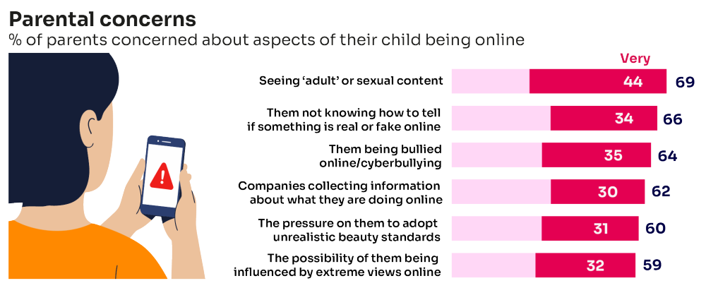
Summary of parental concerns (3 – 17 yr-olds)
Source: Children and parents: media use and attitudes report 2026
Notes:
SHARE RESEARCH: Many parents indicate that they have concerns around various aspects of their children’s online activities
As in previous years parents’ primary concern continues to be potential exposure to age-inappropriate content, in particular, the possibility that their child might see ‘adult’ or sexual content online. Seven in ten parents (69%) say they are concerned about this, including 44% who say they are ‘very’ concerned.
Children not knowing how to tell if something is real or fake online (66%) and the possibility of their child being bullied online/cyberbullying (64%) are the next most concerning aspects of being online among parents.

Slide 10


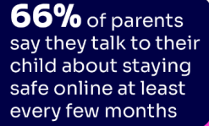
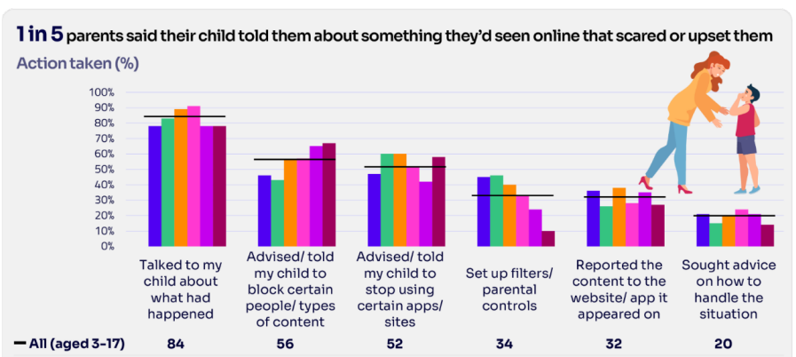
Are you CONFIDENT to TALK TO YOUR CHILD about staying safe online? How OFTEN?
Are there any topics/areas you do not feel confident to discuss?
Source: Children and parents: media use and attitudes report 2026
Notes:
SHARE RESEARCH:
Around eight in ten (81%) parents across all age groups of children say they feel they know enough to help their child stay safe online, including 44% overall who feel strongly that this is the case.
Two‑thirds (66%) of parents say they talk to their child about staying safe online at least every few months, including 43% who do so at least every few weeks. However, 13% of parents say they talk about online safety less often than every few months but more than once a year, 5% say they have talked about it only once, and a further 13% say they have never discussed it with their child.
Parents of 10-12s (80%) are the most likely to have a conversation with their child at least every few months while parents of 16-17s (62%), alongside parents of children aged 6 months to 5 years (53%), are the least likely to have monthly discussions.
TELL:
You do not need to be an IT expert to help your child stay safe online. One of the best things you can do to protect your children is to talk regularly with them about their use of technology- just as you do with all other areas of parenting.
Having an open and honest approach is best - reacting, without involving them or talking to them, can often push behaviour underground, so it still happens, but you are less likely to know about it. This can increase risk to your child.

Slide 11
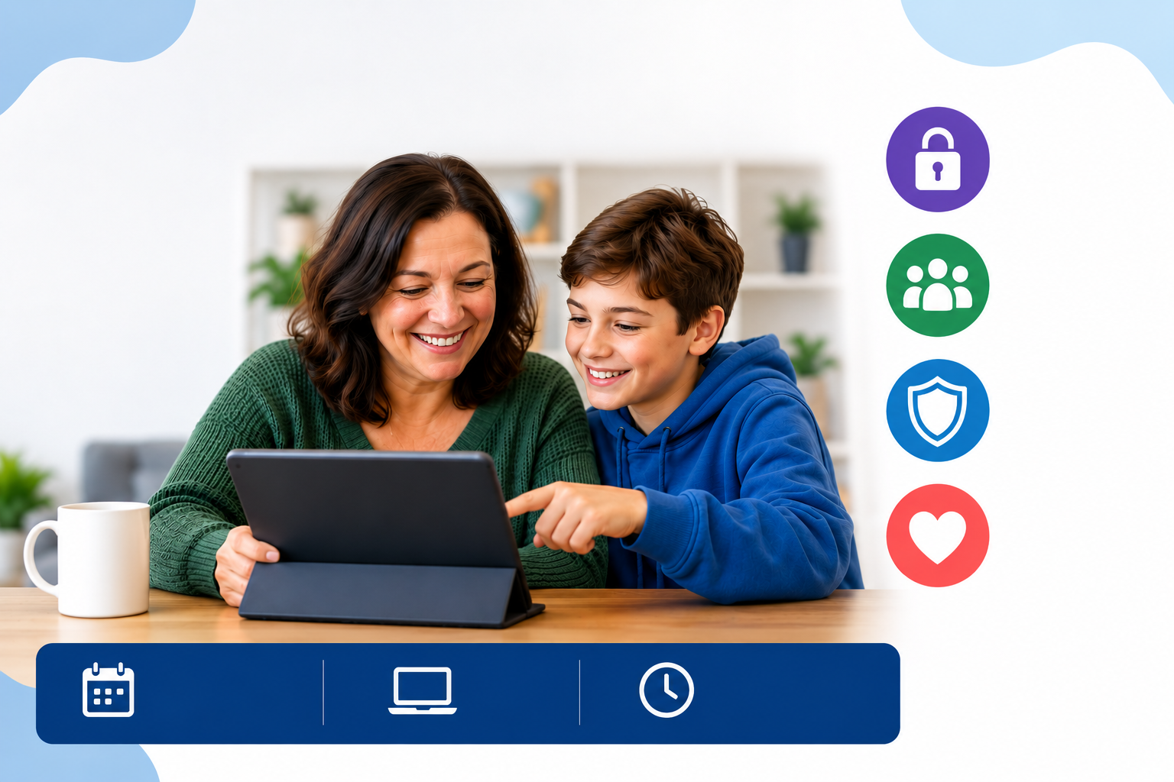
YOU don’t need to be an EXPERT
It’s your choice! | Don’t let others dictate when the right time is to use tech
Stay involved | Make time to communicate, talk about what they are doing. What do they enjoy?
Don’t quiz them | Have regular conversations, e.g. what's their favourite app? Best site to learn new things?
Join in | Watch them play a game and join. Who are they playing with? How do they know them?
‘Show me how..’ | Ask for their help with your privacy settings, who you should add as a friend, are there any risks?
Lead by example | children learn as much from watching, so model good behaviour
Reassure them | Tell them that they won't get in trouble and that you are always there to help
… just be a PARENT
Notes:
ASK – What do you do that works well? Share good practice
REMIND - You do not need to be a tech expert to help your child with staying safe online. It’s ultimately about communication and being proactive.

Slide 12
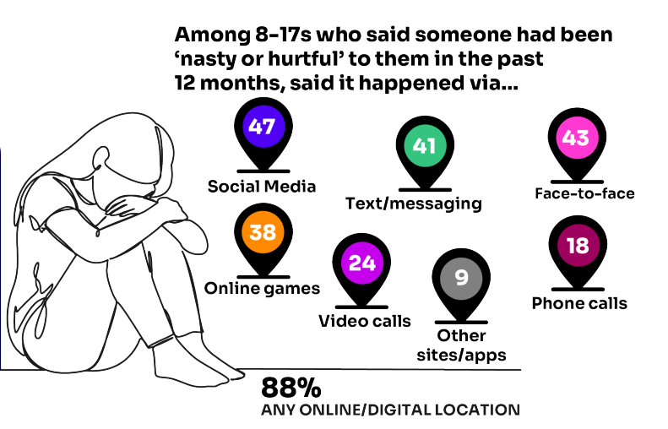
Is your child confident to TALK TO YOU?
83% who saw something ‘worrying or nasty’ say they would tell a family member
Younger children are more likely to tell a parent
Source: Children and parents: media use and attitudes report 2026
Notes:
TELL:
You do not need to be an IT expert to help your child stay safe online. One of the best things you can do to protect your children is to talk regularly with them about their use of technology- just as you do with all other areas of parenting.
Having an open and honest approach is best - reacting, without involving them or talking to them, can often push behaviour underground, so it still happens, but you are less likely to know about it. This can increase risk to your child.
If you are open and approachable about small concerns, children are more likely to approach you when something more concerning happens

Slide 13
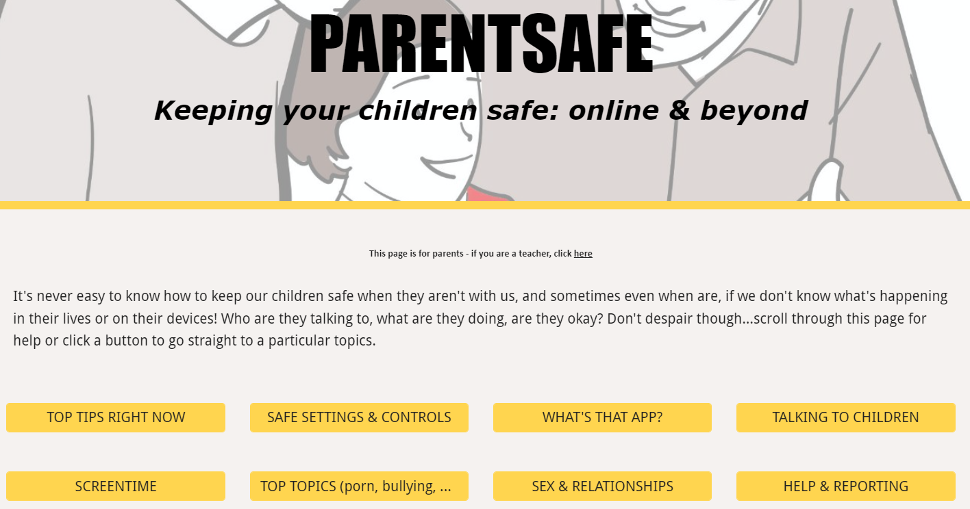
parentsafe.lgfl.net
Notes:
TELL - It's never easy to know how to keep our children safe, especially if we don't know what's happening in their lives or on their devices! Who are they talking to, what are they doing, are they okay? Don't despair though... We’ve created a dedicated website for parents and carers - simply scroll through ParentSafe for help or click a button to go straight to a particular topics. We will look at some of these resources and tips shortly

Slide 14
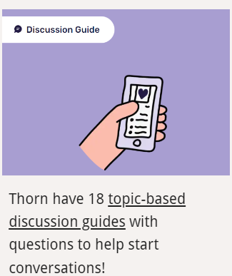

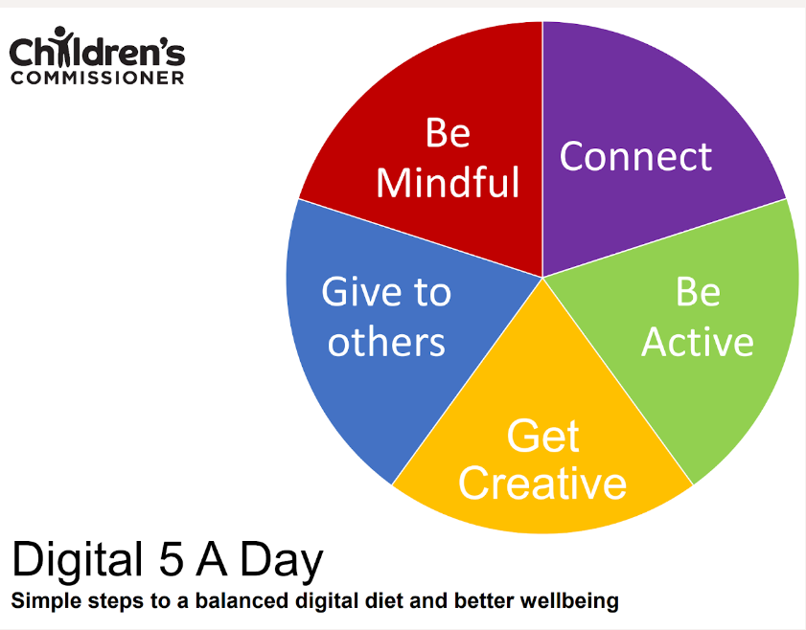



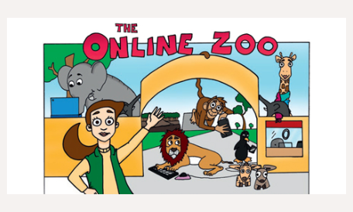
Find conversation starters, story time ideas and top tips to reinforce key safety messages at parentsafe.lgfl.net
Notes:
Feel free to point out some of these free resources for parents to reinforce safety messages and start those key online safety conversations:
TELL:
For younger children, it’s important to talk about boundaries, being kind to others and what they can do if they see or experience anything that worries or upsets them. Story time books e.g. ‘The Online Zoo’ and ‘#Goldilocks – a Fairytale for the Digital Age’ are great ways to discuss risk, consequences and positive strategies in a non-judgemental, age-appropriate way.
For older children, Thorn have 18 topic-based discussion guides with questions to help start conversations!

Slide 15
PARENT ONLINE SAFETY
DEVICE USE AND OWNERSHIP
Notes:
This section is about digital devices –any internet-connected or data-capable electronic equipment
This is an extensive range of devices including:
Laptops, PCs
Tablets
Phones
Gaming devices
Wearable Tech
Home assistants
Music players
Even toys
There are benefits and risks with any digital device use

Slide 16
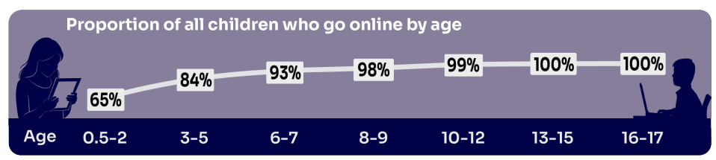
HOW MUCH DO YOU KNOW about your child’s life online?
Almost all children (99%) aged 8 – 17 went online last year, highlighting the centrality of the internet in their lives:
    Younger children commonly use tablets to go online
    Older children are more likely to use mobile phones
Source: Children and parents: media use and attitudes report 2026
Notes:
TELL:
We will be looking at 3–17-year-olds patterns of media use, how they access different sources of media online, and the types of online activities they are participating in. This includes their behaviours and habits in terms of viewing, playing, learning, and interacting
Almost all (99%) their children aged 8-17 go online - this is slightly lower among children aged 3-7 (88%) - highlighting the centrality of the internet in children’s lives.
And we mustn’t forget that being online does create a lot of opportunity and joy for most of us. So, let’s think about how we can minimise risk and reduce their exposure to harm.

Slide 17
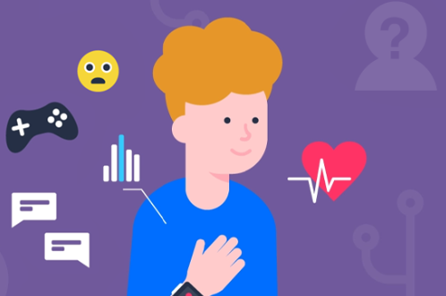
What other DEVICES does your child use?
Children increasingly use wearable technology like smartwatches, smart glasses and fitness trackers
These are often created for adults, so some features might pose potential risks and impact digital wellbeing, safety and security
Wearable technology can also collect real-time data.
Many of these device require an app, which can link to online communities
https://www.internetmatters.org/tech-and-kids-digital-futures/what-is-wearable-technology-safety-for-children/
Notes:
EXPLAIN:
When it comes to choosing the best device for your child, carefully consider the potential risks.
If your child wants to use wearable technology, make sure you look into what data the device collects. Where possible, try to get devices made for children, for example, the Fitbit Ace or SPACETALK kids’ watch.
Make sure you review any app that connects to your child’s wearable and update relevant settings and privacy features to limit interactions with others.
ASK:
What other digital devices does your child access? E.g. Gaming consoles, tablets, pcs, laptops, home assistants, audio players (e.g. Yoto) etc.
We can sometimes become fixated on mobile phones, but there are risks associated with any digital device.
Find further information and useful guidance at:
https://www.internetmatters.org/tech-and-kids-digital-futures/what-is-wearable-technology-safety-for-children/
https://safeblog.lgfl.net/smart-glasses-and-wearable-technology-in-schools-a-safeguarding-guide-for-dsls-and-school-leaders

Slide 18
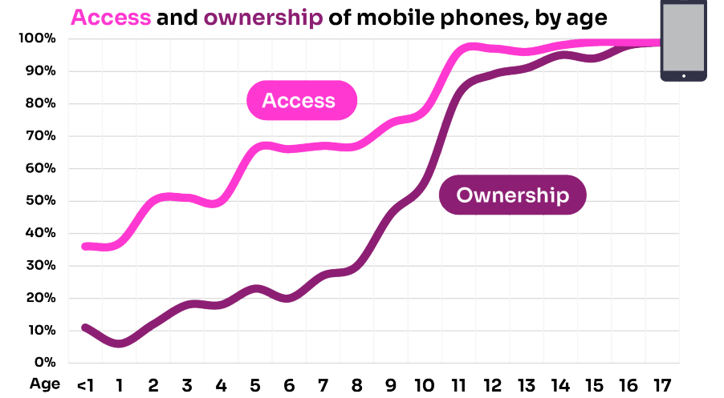
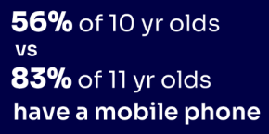
Does your child have their OWN MOBILE PHONE? If so, is it a SMART PHONE?
What AGE do you think is appropriate?
Source: Children and parents: media use and attitudes report 2026
Notes:
By the age of 11 nine in ten (83%) children aged 3-17 own their own mobile phone. In the period before they progress to secondary school, children become more likely to use a mobile phone to go online, while younger children (those aged 10 and under) are more likely to use a tablet.
TELL - A common debate is about the age at which children should be able to use smartphones. These are mobile phones that can access the internet and have apps installed on them. Some parents have opted for non-smart’ phones, which are mobiles that usually only have text and call capabilities.

Slide 19


SMARTPHONE or ‘NON’-SMART / BRICK phone?
NO internet access
Some games
Anytime phone calls and texts
Limited parental controls
Internet access
Social media, apps and games
Notifications
Anytime connection
Parental controls
REMEMBER IT’S
YOUR CHOICE
Every child and situation is unique,
and you are best placed to know their needs
Notes:
ASK THEM TO CONSIDER:
How will they reduce any risks?
What does their child need the mobile for? Is it simply to stay in touch with you - then a ‘non-smart’ phone might be enough. But if you want them to access homework or learning on their mobile, then a smartphone might be better.
How you can help them child learn the basic skills to use it safely e.g. to send a message, take part in a group chat, manage their timings etc. Children need our support with developing these skills. You wouldn’t give your child a knife without guidance and support, similarly a phone can cause harm and so need to think about this.
Whatever they decide, communication is key - involve the child in the process to establish shared expectations.
Remember to set up parental control settings or use a parental controls app to help them stay safe.

Slide 20
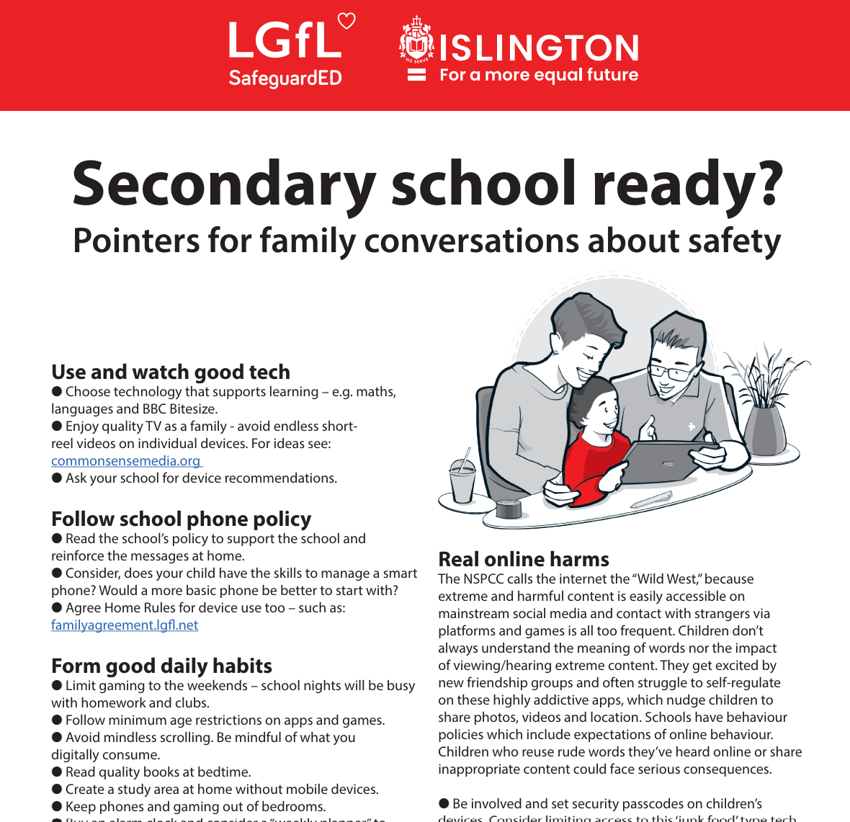
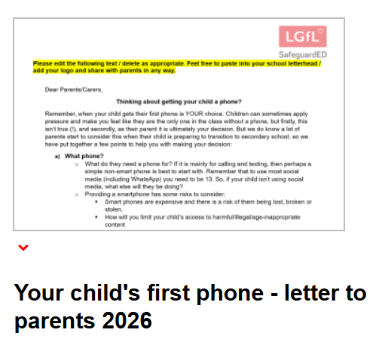
To help you with the transition of pupils from primary to secondary, why not download our FREE Leaflet for parents:
understanding risk
using tech for good
healthy habits and tips
when best to get a phone
Notes:
Take them through some of the key points from this leaflet on healthy habits and using tech for good: https://drive.google.com/uc?export=download&id=1-E_5IiDOfw3EQBPQgbGe9f2Qy3T7o_ny…
Use LGfL’s template letters to provide parents with guidance child’s first phone: https://safepolicies.lgfl.net

Slide 21
INSERT SCHOOL STATEMENT HERE FOR YOUR:
MOBILE PHONE POLICY
WEARABLE TECHNOLOGY POLICY
Notes:
Please customise this slide with anything further you want to tell parents about your mobile phone policy and wearable technology statement.
For further guidance, you can refer to:
LGfL’s template Online Safety Policy and Parent AUP: safepolicies.lgfl.net
Smart Glasses and Wearable Technology in Schools: A Safeguarding Guide for DSLs and School Leaders: https://safeblog.lgfl.net/smart-glasses-and-wearable-technology-in-schools-a-safeguarding-guide-for-dsls-and-school-leaders?utm_campaign=SafeguardED&utm_medium=email&_hsenc=p2ANqtz-8qGfiMbLRFuAb1L08SQxNSCW03cGLtDBAs16E9OZxL8kvY29RBYy8cdVp3edw6Ff_6uilK9BYSJApgMvpiL7dNPIcevw&_hsmi=440105660&utm_content=440105660&utm_source=hs_email

Slide 22
PARENT ONLINE SAFETY
SUPERVISION & PARENTAL CONTROLS

Slide 23
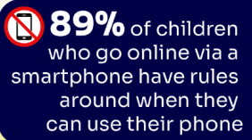
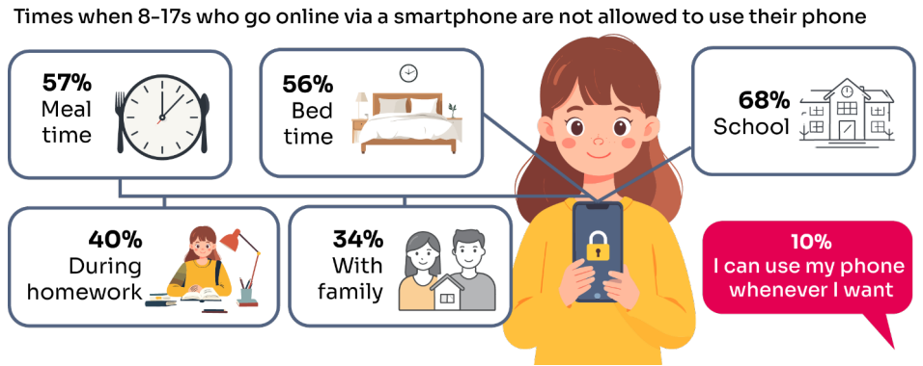
What RULES do YOU SET around using mobile phones?
What do you do that WORKS?
Source: Children and parents: media use and attitudes report 2026
Notes:
ASK: What rules do you set for your children? How confident are you in implementing them?
TELL:
Around nine in ten (89%) 8-17s who go online with a smartphone say there are times when they are not allowed to use their device, with restrictions particularly common among younger children. Around nine in ten (89%) 8-17s who go online with a smartphone say there are times when they are not allowed to use their device, with restrictions particularly common among younger children.
The most widespread restrictions relate to school, with just under seven in ten (68%) children aged 8-17 saying they are not allowed to use their phone during lessons. Eight in ten (81%) say they have rules around when they can use their mobile in their home, most commonly at mealtimes (57%) and bedtime (56%).
However, one in ten (10%) children aged 8-17 say they can use their phone whenever they want, rising to a quarter (24%) of 16-17s.

Slide 24
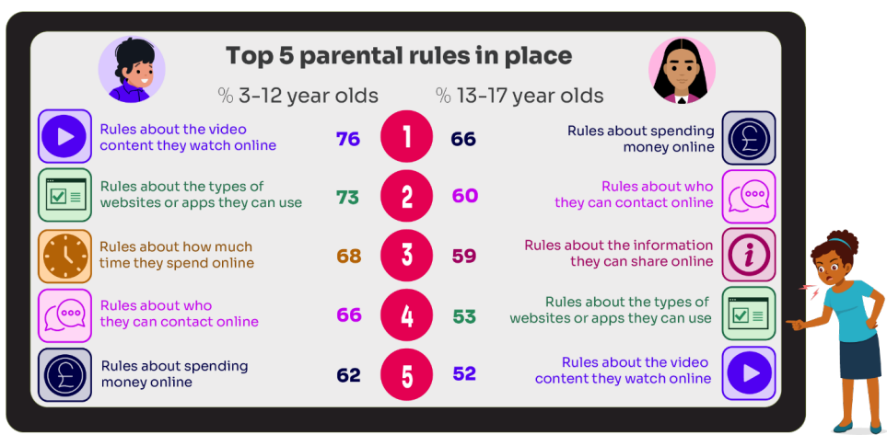
What RULES do YOU SET about being online?
How CONFIDENT
are YOU in implementing them?
Source: Children and parents: media use and attitudes report 2026
Notes:
ASK: What rules do you set for your children? How confident are you in implementing them?
TELL:
Nine in ten (91%) parents of 3-17s who game say they have rules about their child gaming
Managing screen time was the most common way parents described overseeing their children’s online lives

Slide 25

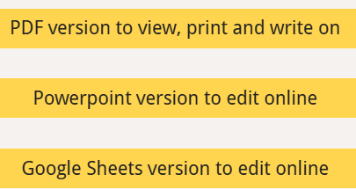
Why not have a family agreement to:
clarify what is allowed...or not
establish ground rules like no phones at the table or in the bedroom at night-time
agree shared expectations to reduce arguments and keep everyone safe & healthy
Download it at:
parentsafe.lgfl.net/digital-family-agreement
Notes:
TELL:
To help facilitate this, LGfL have created a free digital family agreement that parents could sit down and populate with all family members to agree what is and is not allowed within their family around tech use. This includes parents! We as parents also need to role model good behaviour.

Slide 26
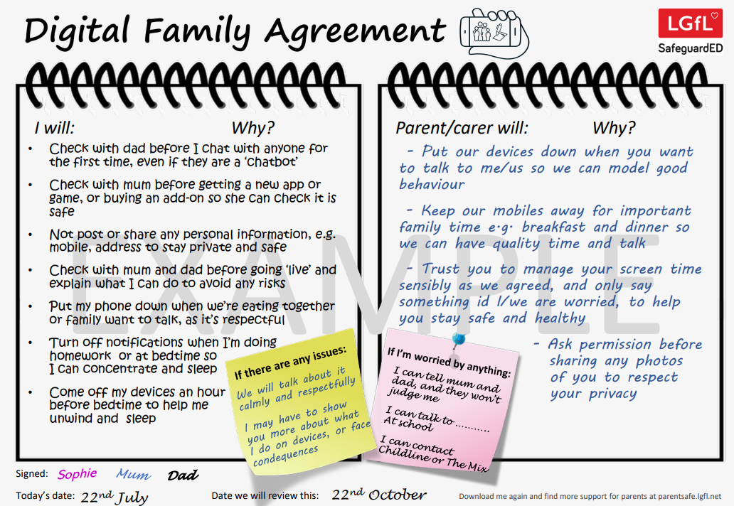
SHARENTING!
parentsafe.lgfl.net
Notes:
TELL - This is an example of a completed agreement – you may wish to take them through the sample statements to help them get started.
ASK – Have they heard of the term ‘Sharenting’?
REMIND – it’s important to model good behaviour when it comes to device use, as children will follow our example. The same goes for ‘sharenting’

Slide 27

What’s wrong with SHARENTING?
(when parents share photos of their children online)
Identity theft
Permanence of digital content
Losing control of images which can be manipulated
Exposure to child predators
Creates their child’s digital footprint before they are old enough to consent
What can you do if you have already posted a lot about your children???
Notes:
TELL:
Sharenting is when parents share photos of their children online. Usually, images are shared on social media platforms to capture memorable moments in children’s lives, such as first steps, trips to the zoo, school performances, and holidays.
more than 75% of parents have shared their children’s images on social media, and 33% have never asked their children for permission before sharing photos online.
EXPLAIN THE RISKS:
Identity theft - sharenting habits expose incredible amounts of personal information about their children. More than 80% of parents use their kids’ real names on social media posts.
Permanence of digital content – even if a post is deleted, someone could have taken a copy, which could put the child at risk or lead to bullying or teasing in the future
Losing control of images - most social media sites own any content posted to their platforms. This clause is usually hidden in the terms and conditions that most users scroll through without reading. This means the platform on which it is shared has ownership of the image.
Exposure to child predators - images parents share can contain information that allows predators to track children. E.g. school or uniform, street name of the family home, while geotags can allow people with nefarious intent to track the child’s real-time location. In addition, because parents cannot control how far these photos spread, it is impossible to know where they end up, even with privacy controls in place.
Since sharenting essentially creates their children’s digital footprints before they are old enough to consent to it, the practice can also create privacy issues between children and parents that can erode trust in that relationship. For all these reasons, it is important for parents to think twice before posting about their kids.
SHARE: UNICEF guidance on sharenting - https://www.unicef.org/parenting/child-care/sharenting
If a parent is rethinking how they share and how much they share, a good first step is to start looking at what was shared in the past and perhaps deleting what they can. [On some platforms, you can request to have an image removed if you are unable to do so yourself.]
Parents can also start bringing children from around 9-10 years into the process of going through social media feeds and deleting things that are no longer relevant to them. And commit to doing that regularly every few months: going through, look at what you've shared and maybe deleting old information.

Slide 28
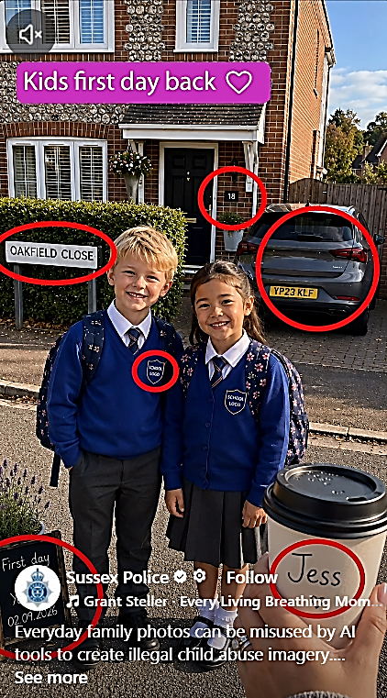
This picture SEEMS NORMAL…
BUT…..
WHY is this post RISKY?
Notes:
TELL – Every family photo can be misused by AI tools to create illegal child abuse imagery
SHARE – this reel from Sussex Police: https://www.facebook.com/reel/1747041216350759
EXPLAIN:
The Internet Watch Foundation (IWF) and the National Crime Agency (NCA) have seen an increase in online offenders exploiting openly available images of children to create realistic sexualised content.
Analysts found 3,440 AI-generated videos of child sexual abuse in 2025, compared to just 13 in 2024, and the NCA have increasingly seen offenders exploiting AI technologies to target children in new ways.
AI child sexual abuse material is illegal and causes real harm, even where an image has been artificially created or manipulated it contributes to the abuse and exploitation of children and can have a devastating impact.

Slide 29
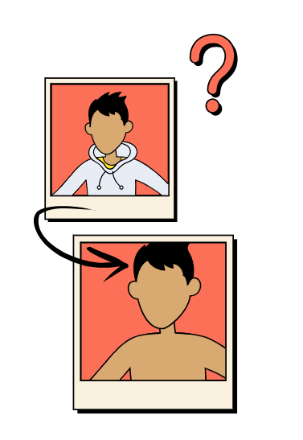
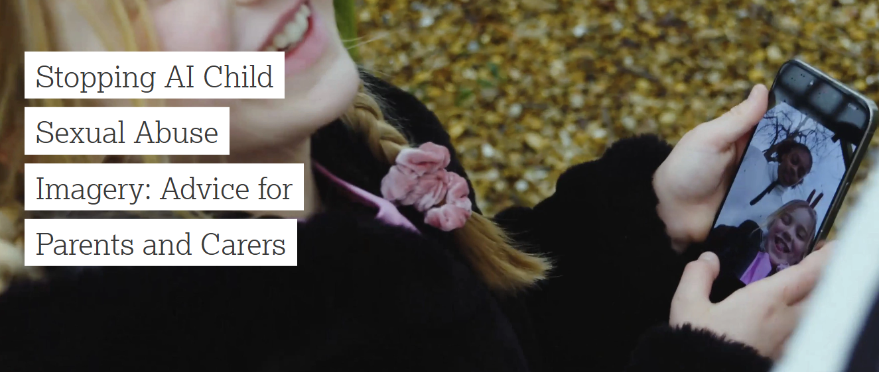
Why not share this guide with parents
https://www.iwf.org.uk/resources/ai-child-abuse-imagery-parent-guide/
Notes:
TELL - Hearing about this as a parent or carer can feel alarming, but you are not alone. It’s important to know that there are steps you can take, many of which you may already be doing, to help better protect your child. This guide from the Internet Watch Foundation (IWF) and the National Crime Agency (NCA) is here to support you. It will help you to understand more about how AI can be misused, why it matters and what steps you can take to feel confident and help keep your child safer online.
SHOW: Take them through some of the key points from this guide on how to protect their child’s photos and start informed conversations: https://www.iwf.org.uk/resources/ai-child-abuse-imagery-parent-guide/

Slide 30
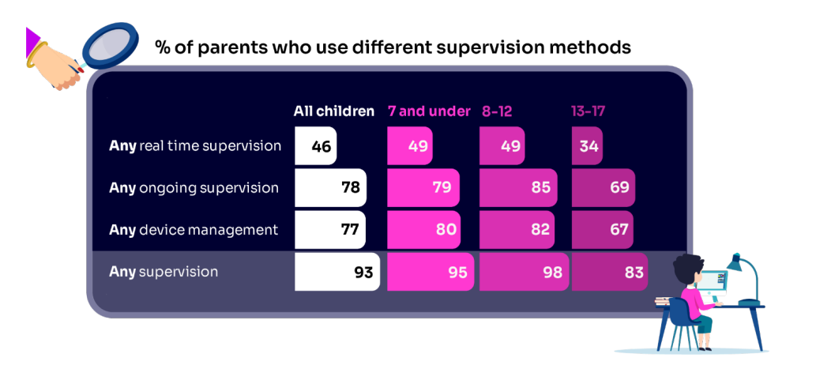
Do you SUPERVISE your child’s online activity? HOW?
Source: Children and parents: media use and attitudes report 2026
Notes:
TELL - Nearly all parents say they usually carry out some form of supervision of their children’s online activity
Almost eight in ten (78%) parents say they use methods of ongoing supervision such as checking their child’s history or asking them to show what they’ve been doing online
(77%) describe using device management tools such as implementing parental controls and screen-time limits on certain app
In comparison, real-time supervision (e.g. sitting with the child, being nearby and checking their device) is less commonly reported by parents (46%). This form of supervision is more common among parents with young children than those with older children (49% among 8-12s compared to 34% among 13-17s).s
Across all its forms, supervision is much higher among parents of 8-12s (98%) than 13-17s (83%). Parents of 13-17s are less likely to do most forms of supervision, although they are more likely than all parents to discuss with their child what they have been doing (37% vs 28%) and to follow their social media account (26% vs 16% for all parents)

Slide 31


Have you set up parental CONTROLS/PRIVACY SETTINGS?
Are these enabled for ALL DEVICES, NETWORKS and APPS?
Controls need to be set up on the broadband connection AND each individual device AND each game/APP used
These do NOT come as standard so it’s worth checking
They are important because they allow you to:
    Block and filter upsetting or inappropriate content or sites
    Prohibit features such as chatting or contact from strangers
    Plan what time and how long your child can go online for
Notes:
TELL – it is important that these controls are set up on BOTH the broadband connection AND each individual device
About seven in ten (73%) parents of all 3-17-year-olds use at least one type of technical tool or control to manage their child’s access to online content; parents of 8-11-year-olds are more likely than those of older children to use at least one of these tools (84% vs 70% of parents of 12-15s and 54% of parents of 16-17s respectively). The most commonly-used technical tool used, across all parents of 3-17s, were parental controls built into the device by the manufacturer, e.g. Windows, Apple, Xbox, PlayStation etc. (32%).

Slide 32
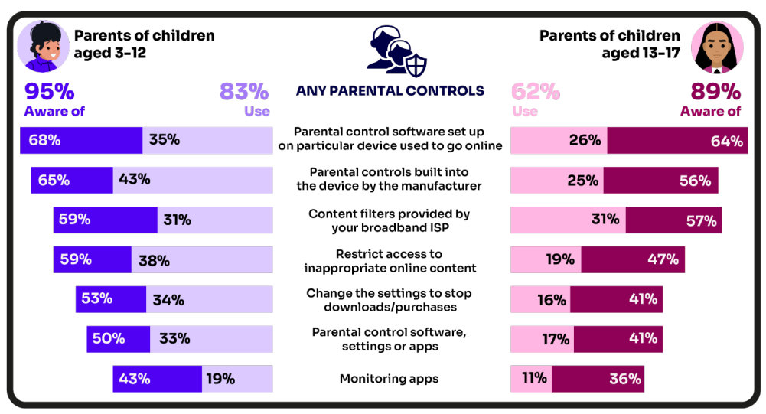
Are you AWARE of these PARENTAL CONTROL TOOLS?
Which ones have YOU USED?
Source: Children and parents: media use and attitudes report 2026
Notes:
There is a high awareness of technical control tools among parents, BUT many are choosing not to use them
ASK – Why do you think this is the case?
TELL – it’s not as complicated or scary as you think. Let’s look at some top tips and resources to support you.
Last year parents of younger children are more likely than those with older children to use at least one type of technical tool or control to manage their child’s access to online content, with 83% of parents of 3-12s using at least one of these tools compared to 62% of parents of 13-17s.
Among all parents, the most frequently-used technical tool or control, out of the options presented to them, continues to be parental controls built into the device by manufacturers (such as Windows, Apple, Xbox, PlayStation etc.).
Parents of 6-7s in particular are more likely to use this type of control
Parents of 8-9- year-olds are more likely to use apps installed on their child’s phone to monitor app usage. Last year, 22% of these parents used such apps

Slide 33
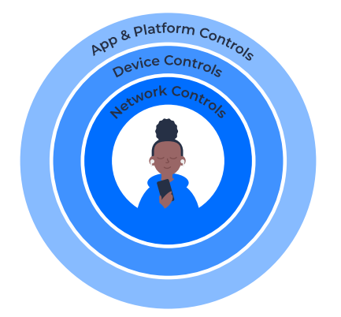
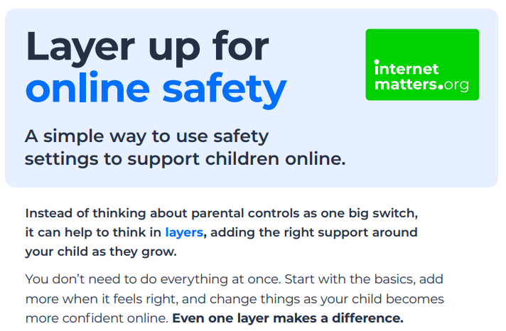
Visit internetmatters.org/parental-controls to find simple parental control guides:
Notes:
TELL – They can use this great page to find out how to set up controls on any smartphone, broadband, social media site/app and games console
REMIND - They need to set up parental controls on each of these individually

Slide 34
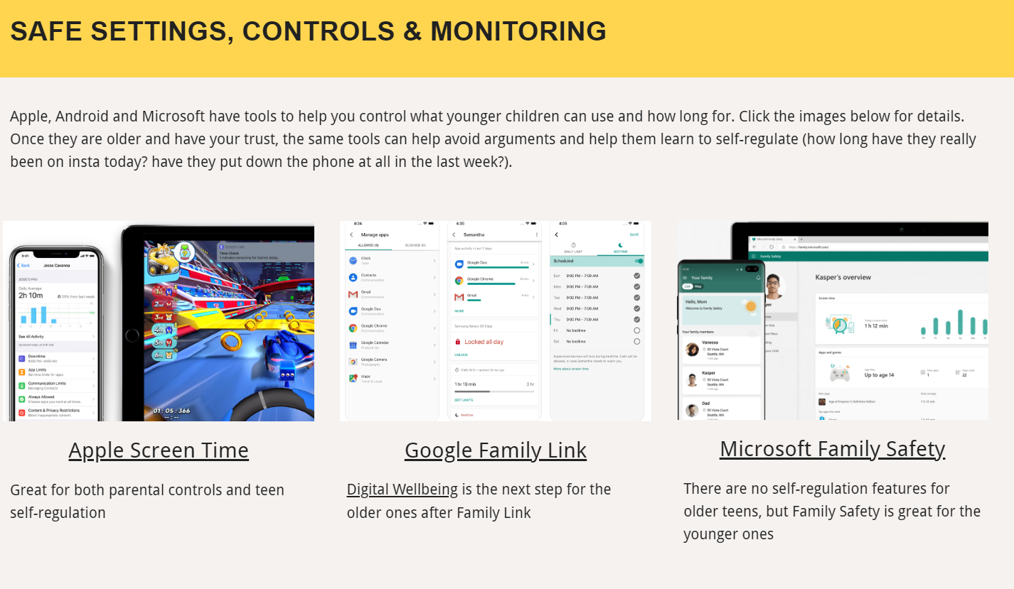
Parental control apps like Google Family Link, Screen Time and Microsoft Family can let you set limits across devices, apps and platforms
Visit parentsafe.lgfl.net/ for additional advice and tips on settings and controls for all devices
Notes:
EXPLAIN - As well as setting controls on your broadband, device, apps, games etc, Parental Control Apps like Google Family Link, Screen Time and Microsoft Family can further enhance safety by letting you set limits across devices, apps and platforms without needing to access these spaces separately. You can manage screen time, app access, inappropriate content restrictions and more.
Screen Time shows you how much time you spend on apps, websites and more. You can also set limits and restrictions for what you want to manage – on your own device or a child's device.
Family link can run on Android devices, e.g. Samsung… Parents can access and manage their child’s account and settings, and delete it if necessary
TIP – Why not run a ‘Bring your device and we’ll show you….’ pupil-led workshop to help parents with this at school?

Slide 35

REMEMBER
As children get older, restrictions and controls you use will change, but only at a pace you feel is appropriate for your child, not pressure from your child “because everyone else is allowed”
Content filters are never 100% effective, at some point your child is likely to come across inappropriate or upsetting content, so make time to talk regularly
Notes:
Many children, even those without their own devices, will see content on siblings/family members/friends devices that may upset, confuse or worry them. So it is critical that every parent builds the right relationship with their child to talk about online safety.

Slide 36
SCREENTIME

Slide 37
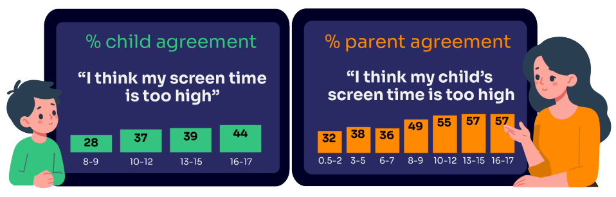
WORRIED about their SCREENTIME?
How do you MANAGE this?
Do you know HOW LONG your child spends daily?
Is it about QUANTITY or QUALITY?
“I’ve been told… that when I get off my screen, I’m less fun to be around.
..And like I can also feel angrier for like no reason.”
Children spent an average 3 hours 5 minutes per day accessing the internet via smartphones/tablets/computers
Around a third (32%) parents of children aged 3-17 report finding it hard to control their child’s screentime
Source: Children and parents: media use and attitudes report 2026
Notes:
TELL:
Overall, around a third (32%) of parents agree that they find it hard to control their child’s screen time. This increases as children get older, rising to four in ten (41%) parents of 13-15s and half (49%) of parents of 16-17s.
In general, children are less likely than their parents to say that their screen time is too high. For example, under four in ten (37%) 8-17s say they think they spend too much time on screens, compared with over half (55%) of parents of children the same age.
We can be focused on the amount of minutes spent on devices, but actually the concern often relates to what they spend their time doing online and with whom.

Slide 38
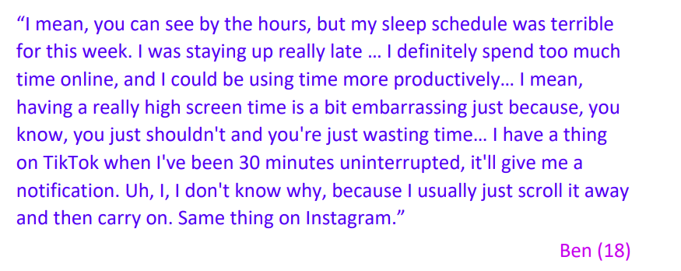
Several children said they spent too much time online, particularly on social media. Some called themselves “addicted” to certain social media
WHY do you think they find it hard to switch off?
WHAT can they do to manage this?
Source: Children and parents: media use and attitudes report 2026
Notes:
reward-based features (e.g. daily challenges)
TELL:
Children and their parents shared examples of platform design features that were influencing children’s time spent across gaming, social media and video sharing platforms.
The research analysis identified four key categories of persuasive design features which make it more difficult for the children to manage their time on online platforms:
social influence (e.g. real-time visibility of friends)
impulse activating (e.g. live in-game events),
dissociative (e.g. auto-play)
EXPLAIN:
Two-thirds of 13-17s have taken active steps to manage their own time online. this includes things such as disabling notifications on devices or using ‘do not disturb’ settings (29%), setting time aside for themselves when they are not online (28%), taking a deliberate break from social media apps (21%) and not taking devices to bed (21%).

Slide 39
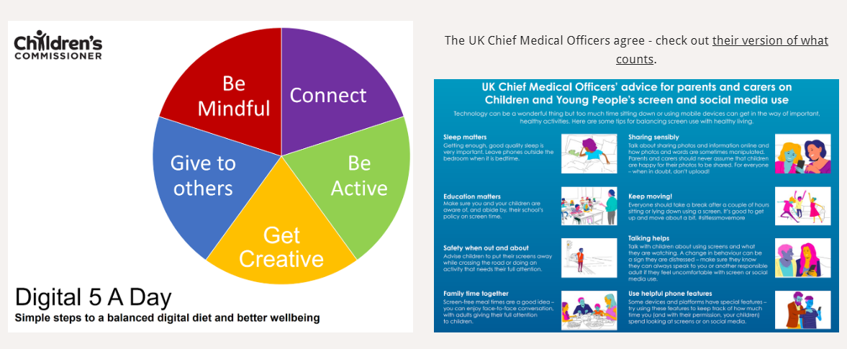
Do YOU think lots of screen time is a BAD thing generally? WHY?
How long is OK?
Visit parentsafe.lgfl.net/ for advice and tips to manage screentime
Notes:
SHARE - World Health Organization (WHO) recommendations and research:
Infants (1 – 2 years) are recommended no screentime, whilst for 2 – 4-year-olds sedentary screen time should be no more than 1 hour; less is better.
When sedentary, engaging in reading and storytelling with a caregiver is encouraged
Improving physical activity, reducing sedentary screen time and ensuring quality sleep in young children will improve their physical, mental health and wellbeing, and help prevent childhood obesity and associated diseases later in life.
TELL – It’s not necessarily how long they are online but what and when they are doing that counts - take them through the UK Chief Medical Officer’s advice poster above for examples
EXPLAIN – the Digital 5 A day gives children and parents easy to follow practical steps to achieve a healthy well balanced digital diet, by encouraging them to reach of the targets in the pie chart – share some examples with them https://www.childrenscommissioner.gov.uk/digital/5-a-day/

Slide 40

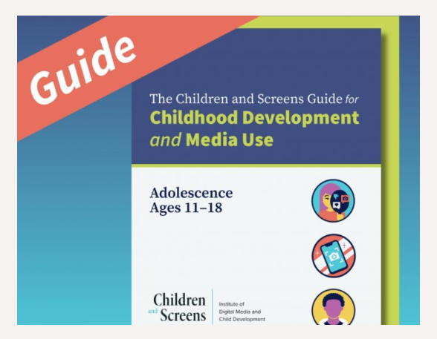
Screen use in the Early Years guidance
Parenting tip Sheets for Adolescence
Visit parentsafe.lgfl.net/ for advice and tips to manage screentime
Notes:
TELL – Today’s adolescent typically spends eight hours a day online, and must grapple with complex developmental changes, from a changing sense of identity, to understanding concepts such as purpose, and social norms
SHARE:
Parenting tip Sheets for insights and research to help support adolescents’ well-being and healthy relationships with digital media
If their child is in the Early Years, take a look at the government's guidance on what good screentime looks like

Slide 41
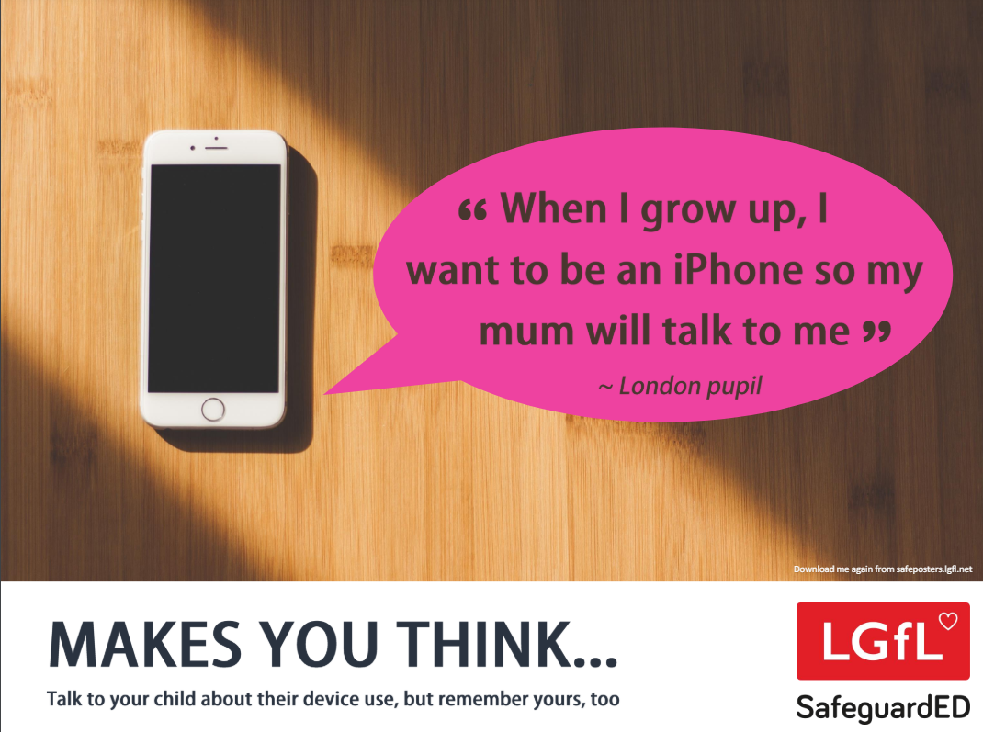
How does your child feel about YOUR SCREENTIME?
52% of 8-11s feel that their parents’ screentime is too high
33% of 8-17s feel that their own screentime is too high
Source: Children and parents: media use and attitudes report 2026
Notes:
Of the third of online 8-17s who think their screentime is too high, just over half (52%) also think their parents’ screentime is too high, compared with the 15% who do not think their parents screentime is too high, and a quarter (26%) who are not sure.
REMIND – it’s important to model good behaviour when it comes to device use, as children will follow our example. The same goes for ‘sharenting’

Slide 42
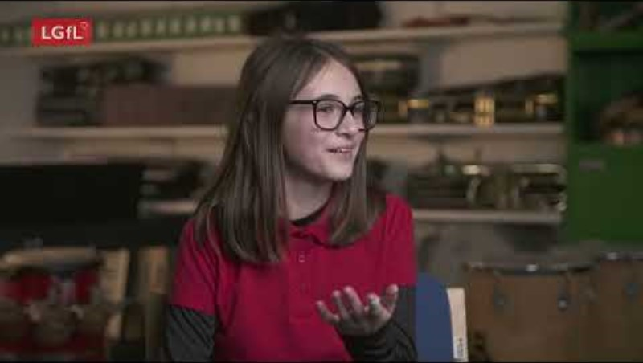
Notes:
PLAY VIDEO – ‘Life Online - What Grownups Just Don't Get!’
This video is part of our playlist on what children and young people actually think about some of the top topics and hot potatoes of the day in 2024. You can discuss key points from this to facilitate conversations to break down barriers to keeping children safe online.
https://youtu.be/Lde52EtjljQ?si=QZSHL0Gn31LRCO1T

Slide 43
PARENT ONLINE SAFETY
SOCIAL MEDIA AND GAMING

Slide 44
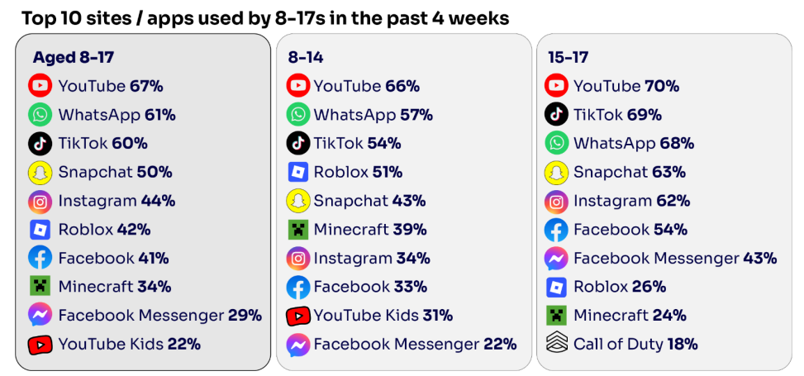
Are you FAMILIAR WITH THE APPS and GAMES your child is on?
85% of under 2’s look at a screen
Seven in ten who use social media and messaging apps say there is pressure to be popular
56% of 10 yr-olds vs 83% of 11 yr-olds have a mobile phone
8-14s are most likely to have profiles on WhatsApp (57%), TikTok (%) or Snapchat (43%)
YouTube is the most popular - the appeal of many social media platforms varies by age
Go to apps.lgfl.net for guidance on apps and social media sites
Source: Children and parents: media use and attitudes report 2026
Notes:
TELL:
YouTube (not including YouTube Kids) was the most selected site/app among all age groups (including 66% of 8-14s and 70% of 15-17s). WhatsApp (58% of 8-14s and 68% of 15-17s) and TikTok
(55% of 8-14s and 69% of 15-17s), came next.
While for 15-17s, other social media sites/apps followed this (including Snapchat, Instagram, Facebook, and Facebook Messenger), the next most popular site/app for 8-14s was Roblox (51% vs
26% for 15-17s).
REMIND – your children need to be 13+ to use these platforms (See slide 39)

Slide 45
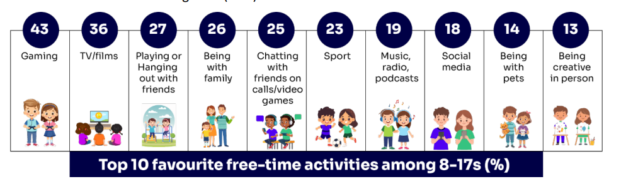
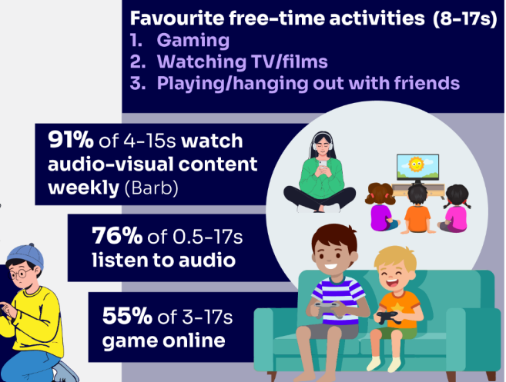
KNOW WHAT THEY DO in their free time?
While the top ten free time activities selected by children include a mix of online and offline activities, the top two activities involve devices
Source: Children and parents: media use and attitudes report 2026
Notes:
TELL:
Boys are much more likely than girls to select gaming as one of their top three free time activities (60% vs 24%), as well as sports (34% vs 12%).
Girls are more likely than boys to select activities such as being with family (30% vs 23%), playing or listening to music, radio or podcasts (24% vs 15%) and browsing social media (20% vs 16%).
Younger children are more likely than older children to select gaming, being with family, being creative in person, reading comics or books and dance.
Older children are more likely to select chatting with friends on calls or video games, playing or listening to music, radio or podcasts, and browsing social media.

Slide 46

KNOW WHAT THEY DO on social media?
Eight in ten (81%) children use at least one social media app/site for following friends, people and organisations, reading, liking or sharing content
A third (34%) are ‘active’ – they typically share, comment or post
Most children used it to passively consume content, typically scrolling and watching short-form content. When they did share content, they were more likely to repost
Source: Children and parents: media use and attitudes report 2026
Notes:
TELL - Motivations for using these types of app vary, but a key reason is the desire to connect with peers. Seven in ten (68%) 8-17-year-olds who use social media and/ or messaging sites or apps told us that using these types of sites or apps helped them feel closer to their friends, either all or most of the time.
EXPLAIN - ‘Active’ activities on websites/apps become more common as children get older: more than a third (36%) of all 13-17s say they upload videos, compared to around two in ten 8-12s (22%) and 15% of 3-7s

Slide 47
What kinds of RISKS do you think children could be exposed to ?
Seven in ten say there is pressure to be popular on social media and messaging apps
WHY is this RISKY?
Source: Children and parents: media use and attitudes report 2026
Notes:
ASK – What kinds of risks do you think children could be exposed to? Can you give examples?
SHARE – summary of parental concerns on the slide
EXPLAIN - Young people can get around age restrictions on apps and websites, increasing the risk of them coming to harm online. Addictive algorithms can make it harder to take a break and maintain a healthy balance between time on and offline. Algorithms can also target content similar to what you’ve already selected/liked/shared. This can prevent them from finding new ideas and perspectives, create misinformation and reinforce stereotypes
.

Slide 48

What might they NOT BE TELLING YOU???
Nearly six in ten (56%) 8-17s use multiple profiles on at least one social media platform
(23%) said it was because one account was just for parents/family to see
15% said one account was for the ‘real me’ and another contained edited/filtered posts or photos
Source: Children and parents: media use and attitudes report 2025
Notes:
TELL - This demonstrates that at least some children feel the need to present distinct aspects of themselves on social media, depending on the audience.
Source: Children and parents: Media use and attitudes report 2025 (no data produced this year)

Slide 49
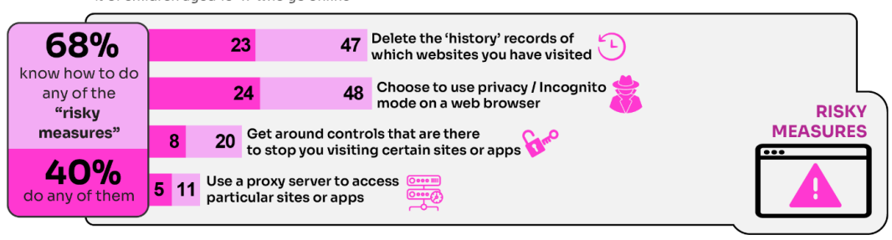
40% had engaged in ‘risky’ behaviour!
WHY do you think this behaviour is ‘RISKY’?
Source: Children and parents: media use and attitudes report 2026
Notes:
TELL - This behaviour is considered ‘risky’ because they enable the child to conceal their online activity, preventing a parent or appropriate adult to ensure they are keeping safe online.

Slide 50
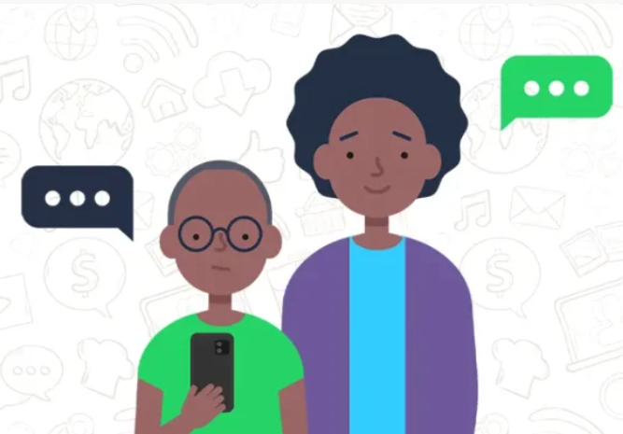
What about WHATSAPP? What are the RISKS?
Unwanted contact | All you need is a phone number or user name which could expose you to unwanted messages or calls
Inappropriate content | Messages are end-to-end encrypted which means content cannot be monitored. This means that your child could see or hear harmful or upsetting content e.g. pornography or violence
Location sharing | Live location feature means that your child could reveal their current location to others
Cyberbullying | Children could be bullied, feel left out or deliberately excluded from groups
Oversharing | Privacy features e.g. disappearing messages might mean your child feels safe to reveal private or risky information or images, which could be copied and shared Whatsapp channels are designed for public broadcasting rather than small trusted groups and their privacy tools do not offer adequate protection for younger users.
Do you know the minimum age to use this?
Notes:
TELL: To use the service in the UK, users must be 13-years-old or older (as of April 2024. The minimum age for WhatsApp used to be 16)
EXPLAIN - Some in-built features are particularly risky for children:
WhatsApp lets users send messages and content to each other. Up until now, this would be to contacts added to their account, so they would need your phone number. Now however, WhatsApp has introduced usernames, a unique handle, a bit like an Instagram or Snapchat username, that people can use to message each other instead of a phone number. This is risky because Usernames are easier to share than numbers, and they can still be guessed, leaked, or shared around, exposing them to unwanted contact
Creating a Channel brings a number of risks that are worth mentioning:
Strangers following the Channel
A link shared once can move quickly. Followers may not always be who your child expects.
Unwanted attention
Posting videos or photos can lead to comments outside your child’s control. Even simple emojis can feel negative or hurtful.
Pressure to perform
Channels feel like public platforms which can encourage posting more often or in ways that attract attention.
Digital footprint concerns
Videos posted at a younger age could resurface years later. Many children do not fully understand the long term impact.
Lack of privacy and safety controls
There is currently no feature inside Channels that allows parents to restrict who sees posts or who follows
You can find out more here - https://www.waynedenner.com/whatsapp-channels-what-parents-need-to-know/

Slide 51
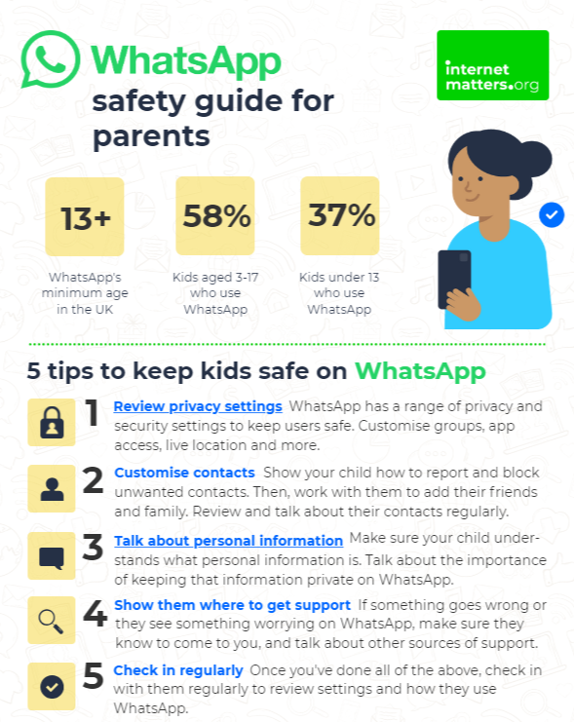
What can you do as a parent?
Visit https://www.internetmatters.org/resources/whatsapp-safety-a-how-to-guide-for-parents/#whatsapp-safety-tips for advice for parents
Notes:
SHARE – 5 top tips from the parent safety guide at https://www.internetmatters.org/resources/whatsapp-safety-a-how-to-guide-for-parents/#whatsapp-safety-tips
EXPLAIN – it’s useful to talk with children about etiquette when using group chats e.g.
how to communicate
what language to use/not use
recognition that others may see your messages if copied and shared
what to do if someone is unkind to them or others etc.

Slide 52
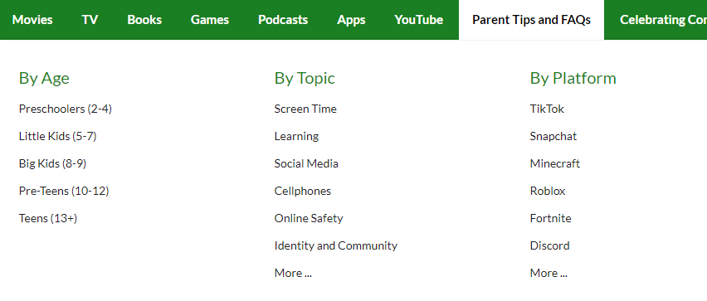


Find ratings and reviews for parents on apps, games and social media at commonsensemedia.org
Notes:
REMIND – they don’t need to be experts, but they can empower themselves by finding out about the suitability of the games/apps their child uses
SHOW – the Common Sense Media page and pick an app or game to show how easy it is to find a review

Slide 53
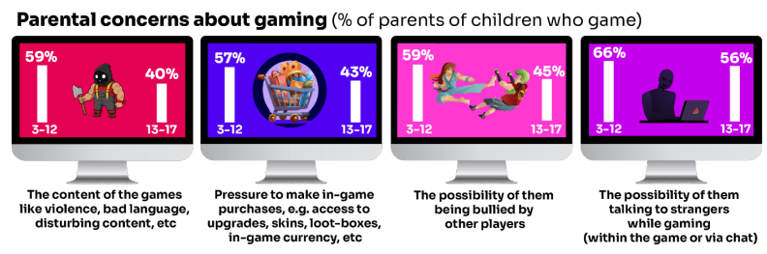
What are YOU most WORRIED about in GAMING?
Visit gaming.lgfl.net for advice and activities
Source: Children and parents: media use and attitudes report 2026
Notes:
TELL:
The most cited concern among parents of 3-17s whose child plays games is the possibility of their child talking to strangers while gaming, either within the game or via the chat function (64%).
This is followed by concerns about their child being bullied by other players (60%), exposure to inappropriate content in the game such as violence, bad language or disturbing material (59%), and pressure to make in-game purchases (51%).
Overall, parents of younger children are more likely than parents of teenage children (13-17s) to be concerned about these possibilities
EXPLAIN:
Every gaming platform offers safety settings – learn how to set these up effectively for different devices.

Slide 54
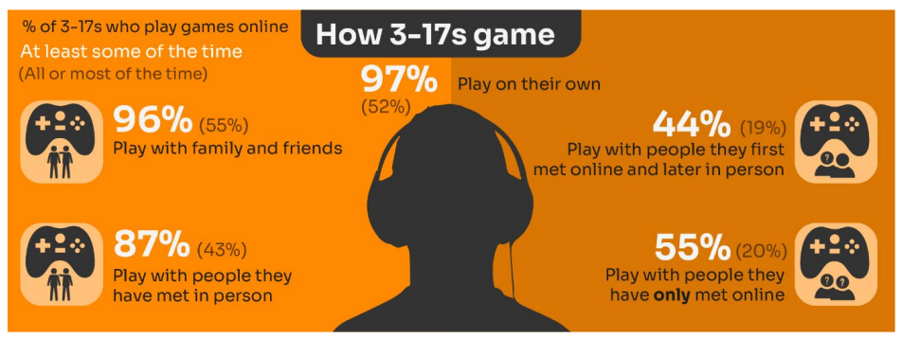
Know the DIFFERENCE between an ‘ONLINE’ FRIEND and real one? How does this differ from your CHILD’S VIEW?
Familiar with who they are in contact with whilst playing games?
Have you asked about the chat facility?
Do you know the content and age restrictions for these games?
Why is this risky?
Visit gaming.lgfl.net for advice and activities
Source: Children and parents: media use and attitudes report 2026
Notes:
TELL:
Children often use online gaming as a tool to communicate with their peers, spend time with friends or family members, as well as an opportunity to meet new people. Some of the children emphasised the social aspects of play, including talking and messaging others, as well as the gameplay itself.
However, many also play with people they have only met online. Over half (55%) of those who game online say they do this at least sometimes, while one in five (20%) do so all or most of the time. A higher proportion of these children now play shooter games. This may raise concerns about how age appropriate the games favoured by some younger children actually are.
EXPLAIN:
While communication via games is a valuable social tool for many children, it can sometimes leave them vulnerable to unwanted interactions. This year (12%) of all children aged 8-17 said someone had been nasty/hurtful to them through an online game
As well as extremist thinking, gaming chat rooms can provide a route for children & young people to be groomed into gambling and child criminal exploitation, as well as becoming victims of financially motivated sexual extortion 'sextortion'.

Slide 55

  Research finds children’s online spaces “saturated” with GAMBLING-like content and advertising
“They make it look like a game; it does not look like gambling.”
  Risks are not understood by children due to the blurred lines between gambling and gambling-like activity such as loot boxes
Do you DISCUSS this when you talk about MONEY?
How is gambling made to LOOK ATTRACTIVE?
https://www.gambleaware.org/media/hbcp3qgd/exploring-the-lived-experience-and-views-of-gambling-among-children-and-young-people_final_0.pdf
Notes:
TELL: The report found that gambling was understood to be a normal part of everyday life, and children described it as a part of their experience of growing up. Gambling content was seen with things such as horse racing, scratch cards and the National Lottery, while content that felt like gambling was seen in online games with gambling-like features such as loot boxes. The bright, loud and eye-catching nature of gambling adverts drew children and young people in, and many reported that gambling could look like gaming and vice versa, and the look and feel of the two worlds felt interchangeable.
EXPLAIN: Anyone who plays video games will probably have heard about loot boxes. They can contain useful items, in-game currency, new clothing or even characters that could change the way you play. 9 in 10 young people report that loot boxes are available in the games they play. A common practice if a game includes loot boxes is that the game is free. Typically, the game will make their money from selling tempting items in these boxes through a range of tactics –
ASK: Do you DISCUSS THIS when you talk about MONEY to your children and how gambling is made to LOOK ATTRACTIVE and likely that you would WIN?

Slide 56
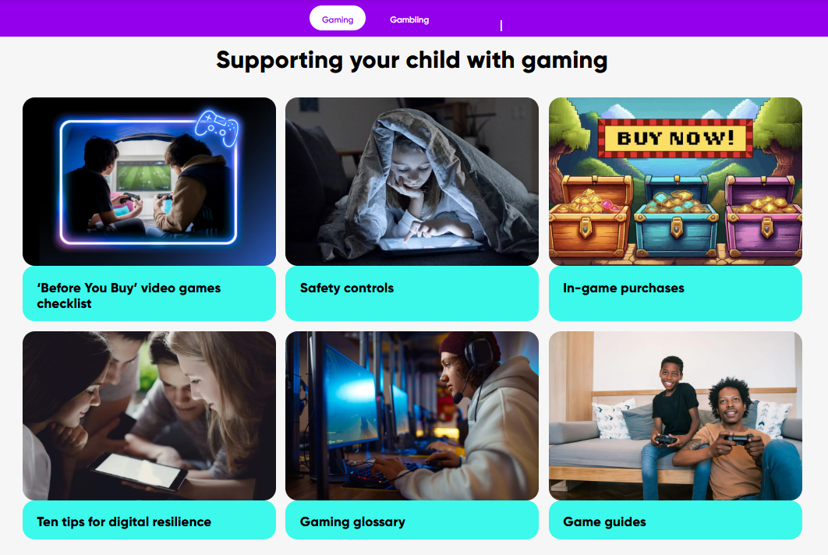
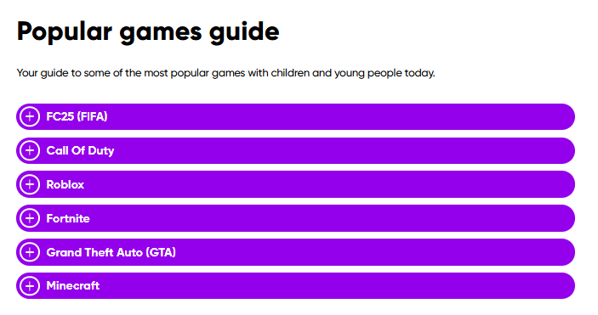
Visit https://ygam.org/family-hub/ for advice and support
Notes:
TELL: the Ygam Family Hub provides parents and carers with free resources, tips and practical guides to help protect children from gaming and gambling harms, e.g.;
Talking to Children
Spotting Warning Signs
Managing Spending
Safety Controls

Slide 57
HOW can YOU GET INVOLVED?
TALK about who they are playing with - what information are they sharing?
EXPLAIN what is/isn’t appropriate to share, e.g. personal details to identify them or location
ASK what type of games your child enjoys – are they age-appropriate?
PLAY games together - keep the tech in shared spaces rather than bedrooms
DECIDE how long is appropriate to play in one session - how many sessions a day
SETUP these restrictions in parental settings with your child
AGREE how they will spend their money online
DISCUSS what they would do if they were bullied online, and what steps to take
Visit gaming.lgfl.net for advice and activities to keep them safe
Notes:
TELL:
A positive relationship with gaming doesn’t have to mean avoiding it altogether – it’s about finding a healthy balance. Young people need support in developing habits that let them enjoy gaming as part of a balanced lifestyle.
Understanding what motivates their gaming – whether socialising with friends, creative expression of competitive achievement – will help you to guide them toward health patterns of play.
Starting the conversation can feel daunting, especially if you have concerns. But encouraging open dialogue about their digital world will help build trust and opens up natural opportunities to have meaningful conversations about both the fun sides and the risks.
Find out more at: https://safeblog.lgfl.net/helping-parents-navigate-online-gaming-guidance-and-advice-for-schools

Slide 58

PEGI helps parents to make informed decisions when buying video games:
The age rating confirms that the game content is appropriate for players of certain age
It considers the age suitability of a game, NOT the level of difficulty
pegi.info
Notes:
TELL:
UK uses the PEGI (Pan European Game Information) system to give games their age ratings to help people make informed decisions when buying video games or apps through the use of age recommendations and content descriptors.
You can find out more here: https://parentzone.org.uk/article/pegi-games-ratings#:~:text=The%20UK%20uses%20the%20PEGI,about%20how%20PEGI%20classifies%20games

Slide 59
PARENT ONLINE SAFETY
AGE REQUIREMENTS
Notes:
This is a good point to mention the social media ban for under 16s – see slides 62 and 63

Slide 60

Are YOU aware of the MINIMUM AGE REQUIREMENT for social media?
Find ratings and reviews for parents on apps, games and social media at www.commonsensemedia.org
Source: Children and parents: media use and attitudes report 2026
Notes:
Awareness of the existence of minimum age requirements is high: more than eight in ten (83%) parents of children aged 6 months to 17 know that most social media platforms have a minimum age.
However, fewer parents can identify the specific age correctly. Around a third (32%) correctly say the minimum age for most social media platforms is 13, with parents of older children more likely to give the correct answer than those with younger children. Half of all parents (51%) give either the wrong answer or don’t know. Children aged 8-17 are more likely than parents to give 13 as the correct answer (40%).

Slide 61

Would you ALLOW your child to have a SOCIAL MEDIA PROFILE before they reach the MINIMUM AGE?
Despite there being a minimum age requirement of 13 for using most social media apps, over half of 3-12-year olds (55%) were reported as using at least one social media app or site
Find ratings and reviews for parents on apps, games and social media at www.commonsensemedia.org
Source: Children and parents: media use and attitudes report 2026
Notes:
Willingness to allow their child early access to social media varies by the age of the child. Parents of children close to the minimum age are the most likely to agree, with 30% of parents of 10-12s and 29% of parents of 13-15s saying they would allow this, compared with 23% of parents of 8-9s.

Slide 62

Do you KNOW what they SHARE?
16% of children who have a social media profile include a photo of themselves which anyone can see
Source: Children and parents: media use and attitudes report 2025
Notes:
Source: Children and parents: Media use and attitudes report 2025 (no data published this year for this area)

Slide 63
WHY is this WORRYING?
33% admit to giving a fake age online to access a new app/site
Four in ten under-13s have a profile on social media apps or sites
Up to a quarter had changed their date of birth on their profile
25% of 8-12 yr-olds were more likely to change it on Snapchat
Children’s Online User Ages 2025 Quantitative Research Study
Notes:
This year, Ofcom cancelled future tracking of this specific "user age" metric as stricter Online Safety Act rules require platforms to implement highly effective age assurance checks rather than relying on self-declared dates of birth.

Slide 64

WHY does this MATTER?
To understand the extent to which children are bypassing age checks, Ofcom researched how many children have online profiles that make them appear older than they actually are?
Source: Children and parents: media use and attitudes report 2025
Notes:
Source: Children and parents: Media use and attitudes report 2025 (no data published this year)
ASK – Why does this matter?
TELL: Many children have online profiles that make them appear older than they actually are – exposing them to content inappropriate for their age and harmful online interaction with other users; for example: peer to peer pressure, commercial advertising and adults posing as children or young adults with the intention to groom or exploit them for sexual, criminal, financial or other purposes

Slide 65

Do you KNOW what an ALGORITHM is? What are the RISKS?
https://learning.nspcc.org.uk/research-resources/2026/impact-harmful-online-content-children
Notes:
TELL: Social media algorithms are complex systems designed to determine what content appears in a user’s feed. They operate behind the scenes on platforms like Facebook, Instagram, and YouTube (as well as Netflix, BBC iPlayer, Spotify etc), tailoring content based on a user’s preferences and behaviours. At a basic level, algorithms are designed to keep users engaged (more engagement = more advertising consumed = more money made). When your child interacts with content - whether by liking a post, sharing a video, or even watching something for a few extra seconds - the algorithm takes note. The more interactions your child has with a certain type of content, the more likely the algorithm is to serve up similar content. For instance, if your child frequently watches makeup tutorials on YouTube, the platform’s algorithm will push more beauty-related videos into their recommendations, encouraging continued engagement.
EXPLAIN:
Algorithms can make it harder to take a break and maintain a healthy balance between time on and offline
Algorithms can also target content similar to what you’ve already selected. This can promote triggering harmful content, prevent you from finding new ideas and perspectives, create misinformation and reinforce stereotypes.

Slide 66

HOW can you SUPPORT your child?
https://learning.nspcc.org.uk/research-resources/2026/impact-harmful-online-content-children
Notes:
SHARE: play the ‘Aggro-rithm’ video from parentsafe.lgfl.net
TELL: there are several practical tips to help support your child:
Talk about and practice reporting harmful content online with your child
Search for accounts with positive and enjoyable content - by searching, following and interacting with accounts that post positive content that your child enjoys, this can help the algorithms to show them more of that content and make their time online entertaining and valuable
Always register accounts with the correct age - social media apps will use the age of the user to help choose content to show them. Making sure that accounts are registered with the correct age can help stop inappropriate content from appearing on their account
Unfollow or mute accounts that you don’t like
Follow a range of accounts with different perspectives - this can help prevent the ‘echo-chamber’ effect of algorithms, as it may help you to be recommended a wider range of content with different ideas and perspectives on important issues

Slide 67

What do you KNOW about the SOCIAL MEDIA BAN FOR UNDER 16s?
Will come into effect early 2027
To include platforms like TikTok, Snapchat, Instagram, YouTube, Facebook and X
Under 16s blocked from livestreaming, including on gaming platforms
Safety restrictions will default on for under 17s to avoid a sudden change at 16
Potential overnight curfews and limits on infinite scrolling for under 18s coming later.
Notes:
ASK – What do you know about the Social Media Ban for under 16s?
TELL:
On 5th June, the UK Government announced restrictions for under-16s on the use of social media.
The UK Government ran a public consultation because of growing concerns about the risks that come with life online - from design features that encourage young people to spend more time on screens, to content that can harm their health and wellbeing.
The Australian Prime Minister, Anthony Albanese, enacted a similar ban there earlier this year, saying just before it was brought in that it would: “keep children safer, take the pressure off parents, and give young people more time to just be kids.”
The social media ban for under-16s will apply to TikTok, Snapchat, YouTube, (but not YouTube Kids) Instagram, Facebook and X.
The ban affects a "wider range of online services, including on gaming sites." Roblox won’t be banned, however some gaming sites will see limitations on access - including "blocks on harmful functions such as livestreaming and stranger communication with children for under-16s." So this may affect elements of interactivity on Roblox.
Messaging services like WhatsApp and Signal aren't included.
Find out more about what schools can do in LGfL’s blog: https://safeblog.lgfl.net/how-will-the-social-media-ban-for-under-16s-impact-schools

Slide 68


REALITY CHECK!!!
This is not a full ban on social media for under 16s – we don’t know the full list of platforms
Only a limited number of apps are likely to be included
There are hundreds of platforms, so children will still have access to social media before 16
Age checks will play a major role but they continue to be ineffective and easy to bypass
Workarounds are already common and likely to continue
https://mollyrosefoundation.org/wp-content/uploads/2026/06/Social-media-ban-announcement-guide-for-parents-1.pdf
Notes:
SHARE – Molly Rose Foundation’s Social Media Ban Guide and scroll through some of the key points
TELL:
The ban is about banning tech companies from accessing children under the age of 16.
The social media ban for under-16s will apply to TikTok, Snapchat, YouTube, (but not YouTube Kids) Instagram, Facebook and X.
The ban affects a "wider range of online services, including on gaming sites." Roblox won’t be banned, however some gaming sites will see limitations on access - including "blocks on harmful functions such as livestreaming and stranger communication with children for under-16s." So this may affect elements of interactivity on Roblox.
Messaging services like WhatsApp and Signal aren't included.
Doesn’t clean up social media for the rest of the population or change the design of the platforms to improve their safety

Slide 69
PARENT ONLINE SAFETY
RISKS AND NEGATIVE EXPERIENCES

Slide 70


Negative experiences:
Notes:
TELL:
A third of 8-17-year-old children are being exposed to content online that they find worrying or nasty, but only 20% of parents report their child telling them they had seen something online that scared or upset them in the same time frame.
The likelihood of children seeing this type of content increases with age - just over a third of 12-17s say they have been exposed to this type of content in the past year (34%) compared to 28% of 8-11-year-olds.
NB. Children aged 8-17 who live with at least one impacting condition (e.g. illness, disability, SEND) are more likely than those without such a condition to say they have seen this type of content (40% vs 29%). This indicates that particular groups of children may be more vulnerable than others to being exposed to potentially harmful content.

Slide 71
Current issues that schools are dealing with right now include:
An internet made for adults accessible to children
Pornography
Threats to harm family members if they don’t…
Gen AI
Bullying
Nudes pressure to share and receiving them
Lack of role models
Grooming Exploitation
Radicalisation
Violent misogyny
Self-harm suicide content
Fake accounts profiles
Disinformation Misinformation what can you believe?
Sexual extortion
Notes:
Talk through the ones most relevant to your school and ask parents if they are familiar with some of these terms, e.g. Gen AI, sexual extortion, misogyny
TELL – we will go over some of these in more detail, but they can find out more at parentsafe.lgfl.net

Slide 72





So, what are the RISKS?
Content
Contact
Exposure to harmful material
Harmful online interactions
Being exposed to illegal, inappropriate, or harmful content, for example: pornography, racism, misogyny, self-harm, suicide, antisemitism, radicalisation, extremism, extreme sexual or physical violence, misinformation, disinformation (including fake news) and conspiracy theories
Being subjected to harmful online interaction with other users or generative AI applications that simulate this; for example: peer-to-peer pressure, commercial advertising and adults posing as children or young adults with the intention to groom or exploit them for sexual, criminal, financial or other purposes
Conduct
Commerce
Personal online behaviors
Commercial risks & financial harm
online behaviour that increases the likelihood of, or causes, harm; for example, making, sending and receiving explicit images, including those generated using AI and online bullying
Risks such as online gambling, inappropriate advertising, phishing and or financial scams. If you feel your pupils, students or staff are at risk, please report it to the Anti-Phishing Working Group
Keeping Children Safe in Education
Notes:
TELL - The 4 Cs of online safety is a useful way to identify online safety risks for children (content, contact, conduct and commerce)
We will now take a look at some of these in more detail over the next few slides

Slide 73


https://parentsafe.lgfl.net/
Notes:
TELL – There is plenty of useful information to support them around these topics at https://parentsafe.lgfl.net/

Slide 74

What does ‘GENERATIVE AI’ mean?
Half of children say they use artificial intelligence (AI) tools
https://www.childnet.com/wp-content/uploads/2025/03/Childnet-Cheat-Sheet-GenAI.pdf
Source: Children and parents: media use and attitudes report 2026
Notes:
ASK – What does Gen AI mean to you?
TELL -Al systems are designed to complete tasks and solve problems that in the past would have needed human thinking. Generative Al (GenAl) allows us to use Al to create new things for us, such as photos, music, emails, and recipes. AI is able to work with and process vast amounts of information to complete the task it is set. GenAl can be found on many different platforms, apps and websites including mainstream social media. Children and young people often use Gen AI for:
Asking questions
Studying and revision
Getting advice
Planning
Coding
Being creative through art or music
For ideas and inspiration
Drafting messages and emails
Analysing data
EXPLAIN: Lots of talk about pupils using it to cheat in coursework but perhaps not as much about some of the very real safeguarding risks
Let’s not forget many gen-ai apps are publicly available to EVERYONE. Many mainstream Social Media and Education Platforms have chatbots or gen-ai functions too!
An Internet Matters report warns vulnerable children are most at risk, with the survey finding 71% of vulnerable children are using AI chatbots. A quarter (26%) of vulnerable children who are using AI chatbots, say they would rather talk to an AI chatbot than a real person, and 23% said they use chatbots because they don’t have anyone else to talk to.

Slide 75

Do you think AI is TRUSTWORTHY?
Taken from X
Notes:
ASK – do you think AI is trustworthy
It is becoming more and more difficult to easily tell if an image or video is AI generated
Some may be created for humour, but there are significant real life consequences if they are created to deceive people, to scare or stoke fear, for political reasons or to destabilise society.
There have been examples of AI generated images being shared online which have led to police being called for example and claims that they are impacting on voting in elections.

Slide 76


Do you think AI is TRUSTWORTHY?
Most children regarded AI as a trusted source of information
https://www.childnet.com/wp-content/uploads/2025/03/Childnet-Cheat-Sheet-GenAI.pdf
Source: Children and parents: media use and attitudes report 2026
Notes:
ASK – do you think AI is trustworthy?
TELL - In the Children’s Media Lives sample, most children regarded AI as a trusted source of information, saying that as the results felt relevant to their questions, they tended to accept the responses AI provided without checking the sources.
SHOW – Childnet’s Parent Leaflet and scroll through key strategies and pointers to help keep children safe: - https://www.childnet.com/wp-content/uploads/2025/03/Childnet-Cheat-Sheet-GenAI.pdf
EXPLAIN: AI is not fully trustworthy for children because it can hallucinate incorrect information, display human biases, and lack the emotional empathy needed to guide young users safely.
Misinformation: AI tools frequently generate incorrect facts or make up information while sounding completely confident, which can mislead children during learning and fact-checking. Fake images and videos are widely being created and shared for political reasons.
Bias: AI is a prediction machine and that means that it is at risk of further entrenching stereotypes that exist . For example you ask for a picture of a nurse and it shows a woman, you ask for a picture of a doctor, and it will likely provide an image of a man.
The "Empathy Gap": Children often view chatbots as lifelike, quasi-human confidantes, but AI lacks real understanding and can mishandle sensitive emotional support or crises.
Privacy and Manipulation: Many AI platforms lack robust parental controls, collect personal data, or may respond in inappropriate, unsafe, or adult-oriented ways
We will now explore some of the risks in greater details, and look at what you can do to support and safeguard your child.

Slide 77

What do you think the RISKS of Gen AI are?
https://www.youtube.com/watch?v=XEsHwss2x8E&list=PLaIzX4UgxCRl8e_36R79fqLp_qt1imm4D&index=3&t=203s
Notes:
TELL - Children and young people are being exposed to online harm with new generative AI (gen AI) tools which are now everywhere online! These include sexbots, AI girlfriends, nudifying sites, etc. If you think 'my child wouldn't see these things', you may think again when you hear more.
PLAY VIDEO: https://www.youtube.com/watch?v=XEsHwss2x8E&list=PLaIzX4UgxCRl8e_36R79fqLp_qt1imm4D&index=3&t=203s

Slide 78

Generative AI – find out how nudify apps might impact young people or why a teenager might make friends with a chatbot
WeProtect
Notes:
TELL: Protect Us is a short film exposing the harrowing ways generative AI applications and chatbots are being weaponised to exploit children online. The video has several dramatised scenarios from real-life stories, so worth watching just one chapter even if you only have two minutes.
PLAY VIDEO https://www.youtube.com/watch?v=OuH-D-au1Ho

Slide 79

Why not share this poster with parents?
https://genai.lgfl.net/
Notes:
Take them through some of the key points from this poster highlighting the safeguarding risks of Gen-AI
TELL: While AI companions and chatbots can offer many positive benefits, they also present potential risks. Here are key concerns to consider:
Privacy risks: AI chatbots often collect and store user data. Ensure children are not sharing personal information.
Inappropriate content: Some AI chatbots may generate responses that are not suitable for children. Even with filters, unpredictable interactions can occur.
Emotional attachment: Children may develop strong emotional connections with AI companions, which could impact real-life social interactions and emotional wellbeing.
Misinformation: AI-generated responses may not always be factually accurate. Children need guidance to critically assess the information provided.
Potential for exploitation: Some AI platforms have paid features or in-app purchases, and some may use persuasive tactics to encourage extended engagement.

Slide 80
Talking to your child about AI
ENCOURAGE
critical thinking-
Teach children to question and verify AI-generated answers rather than accepting them as absolute facts.
SET clear boundaries -Remind children that AI personalities and emotions are entirely artificial and cannot replace human support networks
USE language that identifies it as a tool - E.g. avoid saying ‘him/her/them’ and instead use ‘it’.
AGREE on privacy rules - Talk about what information is okay to share with AI chatbots and what isn’t.
DISCUSS the difference between a real friend and an AI chatbot –
Chatbots cannot feel upset, angry, sad or happy, for example, but a human can.
Notes:
TELL: Many parents / carers worry about the impacts of AI tools including chatbots. Here are some helpful tips to help you start those key conversations to help them stay safe.

Slide 81




Why not share the following with parents?
https://www.internetmatters.org/wp-content/uploads/2026/01/AI_conversation_guide_for_families_Internet_Matters_2026.pdf
How to Talk to Children About Frightening AI Headlines
https://safepolicies.lgfl.net/
https://www.safeaiforchildren.org/how-to-talk-to-children-about-frightening-ai-headlines/
Notes:
Take them through some of the key points from this internet Matters guide to explore AI together and encourage curiosity, critical thinking and healthy digital habits - https://www.internetmatters.org/wp-content/uploads/2026/01/AI_conversation_guide_for_families_Internet_Matters_2026.pdf
Use LGfL’s template letters to inform parents about the risks associated with AI, and your school’s approach to protecting children from these: https://safepolicies.lgfl.net/
TELL: Children are increasingly likely to encounter headlines claiming that AI could threaten humanity, or even cause human extinction. Scroll through the SAIFA guide which explains what the recent headlines mean and offers age-appropriate suggestions for talking about them: https://www.safeaiforchildren.org/how-to-talk-to-children-about-frightening-ai-headlines/

Slide 82


Financially Motivated Sexual Extortion – ‘SEXTORTION’
NSPCC (2024) Young people’s experiences of online sexual extortion or ‘sextortion’. London: NSPCC.
Notes:
EXPLAIN – it is a type of online blackmail involving an adult offender posing as a young person, threatening to release nude or semi-nude images and/or videos of a child or young person, unless they pay money. Victims of any age and gender can be targets - majority of cases have involved male victims aged 14-18
TELL - It’s important to remember that a child or young person is never to blame if they have been blackmailed online. Offenders will have tricked, groomed and/or manipulated them into sharing an image, or created digitally manipulated images of them. The reality is that it could happen to anyone.
SHARE – IWF has a guide for parents of children experiencing sextortion: https://www.iwf.org.uk/resources/sextortion/parents-and-carers

Slide 83



https://www.ceopeducation.co.uk/globalassets/professional/nca-fmse-social-campaign-guidance-doc---english.pdf
Notes:
SHARE –
Financially Motivated Sexual Extortion (FMSE): advice for parents and carers: https://www.ceopeducation.co.uk/globalassets/professional/nca-fmse-social-campaign-guidance-doc---english.pdf - you might wish to scroll through the page and cover key points and advice
CEOP Parent and carers template letter and talk through key points on talking to your child and how to respond https://www.ceopeducation.co.uk/globalassets/professional/guidance/nca_financially_motivated_sexual_extortion_alert_education_eng.pdf
If you wish to explore this further, please refer to https://www.flipsnack.com/internetmattersorg/dealing-with-sextortion-what-to-do-if-you-re-targeted/full-view.html

Slide 84
Livestreaming
16% of children livestream their own videos
3-9 year-olds (1 in 10)
10-12 year-olds (2 – 10)
WHY does this MATTER?
Source: Children and parents: media use and attitudes report 2025
Notes:
Source: Children and parents: media use and attitudes report 2025 (no figures released this year)
DISCUSS - Talk through the reasons why people live stream. E.g. Sharing videos instantly and live can feel exciting, showcase talents, campaign against issues, spontaneously share their thoughts with an audience, Show events like music concerts, tutorials e.g. putting on makeup
ASK – What do you think the risks are??
TELL: Live streaming presents several risks to children and young people which may be divided into whether the child or young person is viewing or is sharing/hosting the live stream.
Exposure to inappropriate or harmful content via live streaming.
Content can be uncensored and spontaneous.
Content can have a harmless title or description yet contain offensive or harmful content without the viewer realising.
Comments on live streams aren’t moderated and can be viewed by everyone, young people could see upsetting or harmful comments.
The host of the livestream might feel bullied or pressured to do something in the moment by comments from viewers that they might not feel comfortable doing.
Young people might feel more confident or comfortable sharing things online than they would offline.
Live streaming provides ease of access for perpetrators to engage with children and young people.
Viewers can also screen record or take screenshots of the live stream, even without the host’s consent.
2. Live streaming can facilitate sexual abuse in different ways
While any legitimate internet platform could be abused by offenders attempting to contact children, live streaming provides an ease of access through the instant, direct connection ‘viewers’ have to ‘hosts’ while watching live streams. Live streaming may therefore facilitate sexual abuse as offenders utilise live streams to groom and exploit children to undress or perform sexual acts.
Offenders may try to move the child away from the public stream to a one-on-one live streaming chat. Some offenders may capture videos/images of the child to store or distribute or use in further blackmail.
Software can be used to record the live streaming of child sexual abuse and/or still images can be captured of the child sexual abuse during the broadcast

Slide 85


Child Sexual Abuse Material (CSAM)
It can also affect younger children!
  https://www.iwf.org.uk/annual-data-insights-report-2025
Notes:
TELL –
1. The Internet Watch Foundation are the only organisation other than law enforcement who can search for and remove child sexual abuse imagery.9 1% of all the content they remove of child sexual abuse material, is ‘self-generated’. Self-generated Child Sexual Abuse Material (CSAM) are images and videos which are taken by children and then shared either:
willingly, usually with a boyfriend/girlfriend, or
unwillingly, through coercion, or
shared by a third party without their consent.
Some of these images end up being distributed, sometimes sold, on the open and dark web by those with a sexual interest in children. Sadly, much of this takes place in home environments, where parents believe their children to be safe. But the internet allows people to access you child, unless you have appropriate controls and settings in place.
2. This is the latest data from IWF – In 2025 they recorded 370,001 children in child sexual abuse images. The age profile of children depicted has remained largely consistent, with the 11-to-13 age group accounting for the highest proportion, followed by 7-to-10-year-olds. However, we are seeing an increase in reports involving 14-to-15-year-olds. One of the biggest increases seen in the previous years data, is the rise in the number of images found of 7-10 year olds. This may surprise some people, as there can be an assumption that this is an issue mainly affecting teenagers.
EXPLAIN - This is one of the reasons why we as schools and parents need to start the conversations as early as possible with children, and to be very considered about when children start using devices and controls around this.

Slide 86
Being safer while live streaming
Talk to them about what they are sharing
Use devices in public spaces e.g. lounge not bedroom
Check privacy and safety settings on the app/site
Be wary of requests to chat in private
Know Support and Reporting functions
Notes:
Tell – Here are some tips to consider keeping your child safe when livestreaming

Slide 87

So, what can YOU do?
undressed.lgfl.net
Notes:
TELL - LGfL have created this series of resources which are appropriate for very young children, the dangers of taking your clothes off if you are using a device.
PLAY – Undressed video: https://undressed.lgfl.net/

Slide 88
Sharing Nudes / Semi-Nudes
Older girls (aged 16-18) were more likely than boys to have ever been exposed to potentially uncomfortable or unwanted types of contact:
  Asked to share naked/half-dressed pictures of themselves 24%
  Receiving pictures or videos of naked / half-dressed people
  32%
Source: Children and parents: Media use and attitudes report 2025
Notes:
Source: Children and parents: Media use and attitudes report 2025 (no data produced this year)
TELL: Nudes are self-taken images or videos that show someone nude or partially nude. Other terms may include ‘nude selfies’, ’pics’, or ’n4n’ (nudes for nudes). Young people sometimes share their nudes. Children will sometimes receive these via large group chats or ‘air dropping’ features, so if a child has come across them, this may not be out of choice.
The Online communication among children quantitative research study found that older girls (aged 16-18) were more likely than boys of the same age to have ever been exposed to all ten of the potentially uncomfortable or unwanted types of contact about which they were asked. These include receiving pictures or videos of naked/half-dressed people (32% vs 11%) and being asked to share naked/half-dressed pictures of themselves (24% vs 9%).

Slide 89
Earlier in the year
Taylor (13) received messages from people she did not know that included nude images/inappropriate messages.
12 months later
She had taken steps to reduce this by no longer adding people on Snapchat after they had messaged her on Instagram or using Snapchat’s Quick Add feature to talk to strangers.
“I’d probably get one or two messages a month. They want [to add you on Snapchat] because on Snapchat, you can send pictures that you can’t get away with on Instagram.”
“It… hasn’t happened in a long time. Maybe once in the last year…
It doesn’t happen much anymore because I don’t really talk to people I don’t know any more.”
Children and parents: Media use and attitudes report 2025
Notes:
Source: Children and parents: Media use and attitudes report 2025 (no data produced this year)
SHARE – the example of Taylor above, explaining that children can be exposed to unwanted contact from random strangers
ASK:
What can you do to prevent strangers from adding you?
What else can your child do to protect themselves from people they do not know?
TELL:
To stop random people from adding you on Snapchat, you can turn off the ‘Quick Add’ feature and update your privacy controls in the app, e.g.
Switch toggle off for ‘See Me in Quick Add’
Change settings from ‘Everyone’ to ‘My Friends’ in ‘Contact Me’
Hide you mobile number and email in ‘Settings’
It is also a good idea to follow your child on their social media account – why not ask them to add you as a friend?
You can also refer to https://www.commonsensemedia.org/parents-ultimate-guides/social-media for additional tips for different apps such as TikTok, Snapchat, Instagram etc…

Slide 90




So, what can YOU do?
CEOP
Notes:
TELL:
There are many reasons why a young person might share a nude, including:
curiosity
for fun
as part of a romantic or sexual relationship
pressure to fit in with peers
in search of validation
Understanding why a nude image has been shared can help you best support your child. Let’s watch this video below for one parents’ experience.
SHARE – CEOP provides a series of helpful video overviews for parents & carers on this difficult topic. Play the relevant video to encourage discussion:
youtu.be/XjV0lKYpakk?si=6ONdtZJRjfB6bSRj – what parents/carers need to know
youtu.be/E5LA2nKHVZ0?si=gU3_jXFF51TU3vTq – when should you be worried
EXPLAIN:
It is illegal to create, possess or share nude images of anyone under 18. However, the law is there to protect children and, in most cases where nudes have been consensually shared between young people, police consider a common-sense approach and don’t pursue charges.
Where an adult has asked or forced someone under 18 to share a nude, this is child sexual abuse and should be reported to the police.

Slide 91

KNOW how to TALK to your child about PORNOGRAPHY?
Average age children first view pornography is 13
Substantial proportions viewed it at a much younger age – 27% by age 11 and 10% by the age of 9
Unbearable pressure to view hardcore pornography even if they do not want to
Degrading acts and violence against women
Think it is reflective of real life or healthy relationships
Pornography sites are not the only way, or even the most popular way, that young people access online porn
Wide prevalence of on social media platforms such as Twitter, Snapchat and Instagram
Source: https://www.childrenscommissioner.gov.uk/resource/pornography-and-harmful-sexual-behaviour/
Notes:
TELL: Many children’s first exposure is accidental via social media or others showing them or sending it to them. Seeing it can be quite confusing and worrying for children and so it is important that adults support them
EXPLAIN: It can be challenging to talk to your child about porn. Conversations about sex and pornography can be awkward and you might feel like you have no idea where to start:
Choose the right moment
Listen to what they say about how and what they have seen
Avoid shaming, judging or embarrassing as the child will be less likely to talk to you again
Porn is for adults
Let them know that often porn doesn't reflect reality as the people are actors and are being paid
To make money, sometimes they show things that are shocking
Discuss sexual consent and respect
SHARE: these tips on how to talk to your child about pornography - https://www.keepitrealonline.govt.nz/parents/pornography

Slide 92



Parentsafe.lgfl.net
Source: https://parentsafe.lgfl.net/accessing-pornography
Notes:
TELL: Research shows that young people turn to porn for sex education They see stuff that’s unrealistic and problematic, so it’s good if parents can talk to them about it. The best way to support them is to have open, honest conversations about what they might see and how it’s different from real sex and relationships.
It won’t be a one-off conversation but hopefully this guide from Internet Matters on ‘How to talk about porn’ provides a way to get started: https://www.internetmatters.org/wp-content/uploads/2023/01/Internet-Matters-Online-Pornography-guide-Jan23.pdf
SHARE: Parentsafe’s page on accessing pornography, where parents can find useful guides and videos to support them: https://parentsafe.lgfl.net/accessing-pornography. You might wish to scroll through the guide and take them through key pointers or show the video.

Slide 93
Snapchat: ‘It’s our evening news…’
Disturbing, graphic and illegal content:
  Fights / beatings / stabbings / raids
  Sexual assaults, sex acts involving children, CSAM
  Sale of weapons and drugs online
  (Some see this type of content several times a day, daily)
Wouldn’t consider reporting – seen what happens to a ‘grass’
While other children use Snapchat’s built-in filters to add funny effects to their selfies, the filter these children experience is the normalisation of humiliation, aggression, violence and crime
Source: Revealing-Reality: Anti-social-Media Report 2023
Notes:
Revealing Reality did this research to explore what some vulnerable children are seeing and doing on their phones
CSAM= Child Sexual Abuse Material
TELL - They’re not viewing this content on the dark web, finding it buried on hard-to-reach websites or through clandestine underground networks. They see it on mainstream social media and messaging platforms, primarily on Snapchat.

Slide 94




UK Reporting Helplines and Services for Children and Young People
NCA
Young people can report concerns about child sexual abuse and exploitation to NCA
Report Remove
A free tool that allows children to report nude or sexual images and videos of themselves that they think might have been shared online
ChildLine
A free, private and confidential service where CYP can talk about anything to a trained counsellor, online or on the phone
Call 101 or 999 if there is an immediate risk of harm to your child
Go to reporting.lgfl.net to find out more
Notes:
TELL – Talk to your children about these free reporting helplines to support them if they are worried.
For older children, The Mix provides help for young people aged 11-25

Slide 95
PARENT ONLINE SAFETY
STAYING SAFE ONLINE AND REPORTING

Slide 96

What do YOUNG PEOPLE do to STAY SAFE ONLINE?
Only 15% had used a reporting or flagging function
(36% were aware of these functions)
Go to reporting.lgfl.net to find out how to remove content from social media and where to report bullying, racial hatred, terrorism, sexual abuse and more
Source: Children and parents: media use and attitudes report
Notes:
TELL - It is positive that children generally know about safety measures, but there seems to be a gap in their knowledge about reporting and putting the knowledge into practice.

Slide 97


Do YOU know HOW TO REPORT to apps / sites?
Internet Matters has helpful guides for social media apps and sites at internetmatters.org/parental-controls/social-media
Notes:
Each social media site has it’s own processes for reporting inappropriate/harmful content.

Slide 98

A simple Google search with the site name, e.g. ‘reporting in Snapchat’ will bring up the steps to take and signpost to the reporting page
Notes:
TELL – you can also do a Google search by typing ‘reporting in______________________________ (name of platform)’

Slide 99
Remember!
Check that your child meets the minimum age requirement for the app/game
Remind them to be cautious about accepting friend requests:
a real friend is someone they/you know in real life, not a ‘friend’ they met gaming or in a chat room.
Stress the importance of not sharing personal information with online ‘friends’
Keep passwords confidential
Check privacy settings on devices and individual apps/games
Report any content
e.g. a post, image or harmful, misleading or damaging comment
Reporting doesn't guarantee immediate removal
platforms assess reported content based on their rules and policies
Notes:
TELL:
Age requirements for apps and games depend on legal data privacy rules, content rating systems, and platform policies. Most major social media and messaging apps (like TikTok, Instagram, WhatsApp, and Snapchat) set their minimum age at 13. In the UK and Europe, video game content is rated by PEGI (Pan European Game Information) with categories: 3, 7, 12, 16, and 18
It’s always a good idea to gather as much information as possible before proceeding to download any social media app. Remind them that Common Sense Media gives an overview of the app and also a rating based on opinions from experts, Parents/Carers and children and young people too: https://www.commonsensemedia.org/

Slide 100
UK Reporting Helplines and Services for Children and Young People
NCA
Young people can report concerns about child sexual abuse and exploitation to National Crime Agency
Report Remove
A free tool that allows children to report nude or sexual images and videos of themselves that they think might have been shared online
ChildLine
A free, private and confidential service where CYP can talk about anything to a trained counsellor, online or on the phone
Call 101 or 999 if there is an immediate risk of harm to your child
Go to reporting.lgfl.net to find out more
Notes:
TELL – Talk to your children about these free reporting helplines to support them if they are worried.
For older children, The Mix provides help for young people aged 11-25

Slide 101
PARENT ONLINE SAFETY
CRITICAL THINKING

Slide 102

Does your child TRUST everything they see online?
42% of teenagers say
they use TikTok to access the news
Children feel least confident identifying AI-generated content
Three in ten 8-17s are confident in their ability to tell if something is true or false online, but could not identify a fake social media profile
Source: Children and parents: media use and attitudes report 2026
Notes:
Among 12-15s who do access news, social media is the most common platform used for news consumption. TikTok is the most-used news source, with around four in ten (42%) teenagers saying they use the app or site to access news. This is followed by YouTube (38%) and Facebook (29%).
There continues to be a slight disparity between their confidence in judging whether something online is fake or real and their actual ability to do so:
Just over half (52%) of 13-17s say they are confident in their ability to tell whether content they see online has been produced by AI or not. When tested in practice, however, a quarter (25%) were confident but were unable to correctly identify the AI-generated image shown to them.
This points to a gap between children’s self-reported confidence and their ability to determine whether online content is genuine or not.
TELL – AI (artificial intelligence) has made it easier for anyone to create fake content (text, images and videos), which can make it difficult to distinguish truth from fiction. A notable example of AI-generated misinformation occurred in the United States during the recent presidential election. AI was used to create deepfake videos and false narratives that were disseminated across social media platforms, causing confusion and distrust. This content can be very difficult to distinguish from reality.
ASK – as adults do we demonstrate good critical thinking skills about things we see online?

Slide 103

DISINFORMATION / MISINFORMATION / FAKE NEWS – what do these terms mean to you?
Let us try our Critical Thinking Quiz at believe.lgfl.net
Notes:
TELL – We often interpret information through the filter of our values, feelings, beliefs and past experiences. Things are not always as they appear to be, but with some careful consideration, we can learn to think critically to make the right choices about who and what is trustworthy online.
ASK – as adults do we demonstrate good critical thinking skills about things we see online?

Slide 104
Match the terms to the definitions
Disinformation
Misinformation
Fake news
Agenda
Propaganda
what you want to achieve by sharing certain messages or content
presenting inaccurate stories or hoaxes as factual reporting or journalism
accidentally sharing inaccurate information – not trying to trick anyone
deliberate and selective use of facts and/or misleading information to influence choices, actions or beliefs
deliberately sharing inaccurate information – to trick, confuse or influence
Notes:
Go through the activities on the next few slides together – the correct answers appear in the following slide

Slide 105
Disinformation
Misinformation
Fake news
Agenda
Propaganda
deliberately sharing inaccurate information – to trick, confuse or influence
accidentally sharing inaccurate information – not trying to trick anyone
presenting inaccurate stories or hoaxes as factual reporting or journalism
what you want to achieve by sharing certain messages or content
deliberate and selective use of facts and/or misleading information to influence choices, actions or beliefs
Notes:
ASK parents to come up with an example of each of these terms, either online or offline

Slide 106
Match the terms to the definitions
Stereotype
Opinion
Fact
Context
information that is true and backed up by evidence
background or surrounding information to help you fully understand something that could have a different meaning on its own
a fixed or oversimplified idea about what someone or something is like
a belief based on personal feelings, which cannot be proved

Slide 107
Stereotype
Opinion
Fact
Context
a fixed or oversimplified idea about what someone or something is like
a belief based on personal feelings, which cannot be proved
information that is true and backed up by evidence
background or surrounding information to help you fully understand something that could have a different meaning on its own
Notes:
Explain:
At times, people, whether consciously or not, will frame opinion as fact and vice versa. Others may agree or disagree with an opinion, but they cannot prove or disprove it. This is what defines it as opinion.
It can be difficult to extract truths from a person’s preferences and biases - luckily the language used often throws up helpful clues in the forms of words and phrases to identify statements as fact-based or opinion-based.
Facts and opinions must be placed in context to draw conclusions from them.

Slide 108

Echo chambers create misinformation, reinforce stereotypes and distort one’s perspective, making it harder to consider opposing viewpoints
Social media can act as an ‘echo chamber’ - a place where individuals find their ideas supported and echoed by other like-minded individuals
A filter bubble is
a type of echo chamber created by algorithms that keep track of what you click on
Websites use algorithms to show content similar to what you’ve already selected. This can prevent you from finding new ideas and perspectives online
Sharing things that appeals to others in echo chambers makes it more popular and spread faster – even if it isn’t true!
And makes it easier to confirm existing beliefs
Notes:
EXPLAIN - Young people can get around age restrictions on apps and websites, increasing the risk of them coming to harm online.
Algorithms can make it harder to take a break and maintain a healthy balance between time on and offline. They are designed to serve content to each individual that will make that person spend more time online (to consume more adverts, to make the company more money), and for children and adolescents, it has been shown that violence, self harm, mental health, dieting, body image etc does this. Therefore, this content is served to children regularly.
Algorithms can also target content similar to what you’ve already selected/liked/shared. This can prevent them from finding new ideas and perspectives, create misinformation and reinforce stereotypes

Slide 109

Notes:
ASK – do you think this picture is real or fake?
TELL –
this is an example of a deepfake image. A deepfake is an image, video, or audio recording generated or changed using AI, often swapping a person's likeness into a setting where they never were. It can make them appear to say or do something they never actually did.
It appeared across social media depicting Donald Trump and other world leaders looking towards Russian President Vladimir Putin at the G20 international forum.
Putin was added to the centre of a conversation between Trump, Erdogan, and Turkish Foreign Minister. The empty seat wasn’t even for the “Russian Federation,” as the photoshopped picture showed, but was reserved for the UK.
SHOW – next slide to reveal the actual true photograph
https://www.thewrap.com/the-internets-favorite-trump-putin-pic-is-fake-news/

Slide 110


Slide 111


What can you do about FILTER BUBBLES?
Look at things in context
Look for evidence to separate facts from opinion
Look for the source of the content and try to check to see if it exists somewhere else
Question what you come across and consider other points of view
Follow accounts you might not always agree with, so algorithms can show you a variety of viewpoints
Only share something if you’re certain
Just because you WANT it to be true, doesn’t mean it is!

Slide 112

59% of parents were concerned about them being influenced by extremist content
NSPCC (2026) The impact of harmful online content on children
Visit goingtoofar.lgfl.net to find out how to help children:
  recognise extremist behaviour and content on social media/apps/games
  understand actions likely to attract police investigation
  get help
  report concerns
Source: Children and parents: media use and attitudes report 2026
Notes:
ASK – Have you come across hateful content online? Can you give examples of this?
TELL – Last year, just under one in ten 12-15s said they often saw ‘hateful content’ online. For the purposes of the survey, ‘hateful content’ was described as anything that had been directed at a particular group of people based on, for instance, their gender, religion, disability, sexuality, or gender identity. Overall, half of 12-15s said they had encountered this type of content online in the past year, with 8% saying that they had seen it often.

Slide 113

Are YOU aware of the IMPLICATIONS your ACTIONS could have?
Could you be breaking the LAW?
Or putting yourselves or others at RISK?
Let’s take this quiz together at takingastand.lgfl.net
Visit goingtoofar.lgfl.net to find out more.
Notes:
TELL: How we respond to a hateful post or content can have consequences
EXPLAIN:
Children had adopted different strategies for dealing with hateful content. Six in ten 12-15 year-olds said they had taken some action on seeing it. But some, depending on their actions, might have inadvertently shared the content further. Around a fifth said they had responded to the post/video/comment by ‘disliking’ it or commented on it to say they thought it was wrong, or shared it with their friends, saying it was wrong.
Doing this brings the risk that their action will appear in their own social media feed, which is then seen by others, inadvertently further sharing the content.
Meanwhile, 25% chose to block the person who shared or made the comments, while 22% reported it to the website. Although girls aged 12-15 were more likely than boys to inadvertently share the content by disliking the post/comment/video (27% vs. 13%), they were also more likely than boys to take constructive action in reporting the content to the website (33% vs. 10%).

Slide 114

You notice lately there are lots of posts from a group appearing on your page which are offensive and racist.
What can you do about it?
Notes:
TELL - The following are some examples of scenarios from the Going Too Far ‘What would You Do If?’ quiz that can be used to talk to children about what they would do in similar situations. You can find the complete quiz with all the scenarios at takingastand.lgfl.net. We will now explore some of these scenarios.

Slide 115
Nothing, just ignore them
Report them directly via the site’s report button
Select the option to unfollow or stop seeing posts from this group
Notes:
ASK: what could be the consequences ignoring these posts?
REMIND: free speech does not extend to content that is abusive, hateful or designed to incite violence, and that whilst some hate speech may not be deliberately intended to cause harm it could incite violence, especially as things can escalate rapidly online.
CHECK: Do they know how to report directly on platforms/sites and to unfollow?
** the correct answers change to green when you click ‘next’ in slide show mode

Slide 116

Your class are all talking about this funny meme. It’s making fun of people from another country, and some of the comments are really rude.
There are lots of ‘likes’.
How could you respond?

Slide 117
‘Like’ it – after all it can’t do any harm
Join in the comments so you can also be part of the group
Share it
Report it directly to the site as racism
Talk to a trusted adult for advice
Notes:
ASK: what could be the consequences of joining in with comments, or sharing the meme wider?
EXPLAIN: Even by ‘liking’, they are associating themselves with this narrative and it could be having a damaging impact on their digital footprint.
TELL: whilst they may not be breaking the law, it is a common tactic by extremist groups to post content using humour and relating it to current events. It may not appear implicitly violent or harmless, but is designed to plant a seed and incite strong feelings in people or normalise hateful behaviour. This can make it easier to dehumanise people. So whilst it may seem funny, sharing such content can give legitimacy to extremist views as hateful ideas becomes ingrained and more widely accepted.
REMIND: speak to a trusted adult if they are worried – they can also report directly to the site, or anonymously via reporting channels – signpost them to the ‘Getting Help’ section on the website.
** the correct answers change to green when you click ‘next’ in slide show mode

Slide 118
This pop star tweets a post showing how she’s lost weight by taking these diet pills- she says the first 100 people can get it half price.
What could you do?

Slide 119
Buy them straight away
Think about her motives - she might be being paid to advertise it
Check the reviews
Discuss with a parent/carer before buying anything online
Do your research and to find out more about this subject
Notes:
ASK: can you think of any similar examples of manipulation?
DISCUSS: what could be the risks of going ahead and buying these diet pills?
TELL: it is easy to come across content that is dangerous or damaging to your health as things are not always regulated online, especially on social media.– often the risks of a quick-fix can outweigh the benefits.
REMIND: always check a variety of trusted sources to validate the facts before making any decision, and check with a trusted adult, especially if it involves paying for something.
** the correct answers change to green when you click ‘next’ in slide show mode

Slide 120
An influencer you came across shared a link where you can meet new friends and chat anonymously without worrying about getting in trouble with the law.
What could you do?

Slide 121
Join the chat, after all it’s anonymous so it can’t do any harm
Invite one of your friends to come along so you can both make new friends
Check with a trusted adult at home or school
Notes:
ASK: are you more likely to believe something if it is said by an influencer or celebrity? Why?
DISCUSS: can posts always remain anonymous online?
EXPLAIN: influencer-led events can be appealing but also provide an exaggerated belief in the legitimacy of their claims. Often such chat rooms or forums can take place in an arena surrounded by like-minded people where these views are not challenged – this is called an echo chamber. A person could then be encouraged to explore content on imageboards where users can engage anonymously and more freely in extremist discussions or hear the ‘truth’ without censorship. It’s easy to join in with negative viewpoints online, which in turn can introduce you to harder opinions that are designed to be hateful towards others.
REMIND: social media can act as an ‘echo chamber’ and create misinformation, reinforce stereotypes and distort one’s perspective, making it harder to consider opposing viewpoints.
** the correct answers change to green when you click ‘next’ in slide show mode

Slide 122

Why not share the following with parents?
Select an age-appropriate quiz to play with your child to learn and test their media literacy and fact-checking skills
https://www.internetmatters.org/issues/fake-news-and-misinformation-advice-hub/find-the-fake/
Notes:
SHARE: show Internet Matters Find the Fake Quiz which they can use at home to play with your child to learn and test their media literacy and fact-checking skills - https://www.internetmatters.org/issues/fake-news-and-misinformation-advice-hub/find-the-fake/

Slide 123
PARENT ONLINE SAFETY
RESOURCES AND SUPPORT

Slide 124

Visit parentsafe.lgfl.net for tips and ideas to help parents:
Manage screen time
Set controls and settings
Understand apps and games
Talk to children about risk - from bullying & sharing content, to extremism & gangs
Notes:
TELL:
Remember, the online world can be both exciting and treacherous. Just as you’d look both ways before crossing the street, take a moment to assess the digital landscape.
Stay informed, stay connected, but most importantly, keep talking to your child.
ParentSafe is a dedicated website for parents, to help them to stay up to date with online safety and empower them to have meaningful discussions with their child to keep them safe.

Slide 125
Find conversation starters, story time ideas and top tips to reinforce key safety messages at parentsafe.lgfl.net
Notes:
You may wish to scroll through parentsafe.lgfl.net and showcase some of the resources or videos here too. We’ve selected a few in the following slides for you, but feel free to choose any relevant resources to suit your audience.

Slide 126

Download this FREE poster to put on your fridge
Notes:
TELL - why not put this fridge-friendly poster on your fridge?

Slide 127

Download this FREE
Poster for tips to help if your child has an online tutor
Notes:
TELL - If you have an online tutor for your child, we have some useful tips and areas for consideration in this poster.

Slide 128
You can download FREE family agreement to:
clarify what is allowed...or not
establish ground rules like no phones at the table or in the bedroom at night-time
agree shared expectations to reduce arguments and keep everyone safe & healthy
parentsafe.lgfl.net/digital-family-agreement
Notes:
TELL:
LGfL have created a free digital family agreement that parents could sit down and populate with all family members to agree what is and is not allowed within their family around tech use. This includes parents! WE as parents also need to role model good behaviour.

Slide 129
SHARENTING!
parentsafe.lgfl.net
Notes:
TELL - This is an example of a completed agreement – you may wish to take them through the sample statements to help them get started.
ASK – Have they heard of the term ‘Sharenting’?
REMIND – it’s important to model good behaviour when it comes to device use, as children will follow our example. The same goes for ‘sharenting’

Slide 130
Where to get help?
INSERT SCHOOL SPECIFIC INFO HERE, SUCH AS:
DSL NAMES AND PHOTOS
REPORTING PROCESS (In school and out of school hours)
LINK TO POLICIES
  AUP
  Online Safety Policy
  AI Policy
FILTERING AND MONITORING APPROACH (In school and out of school hours)
Notes:
Please amend this slide with anything further you want to tell parents about reporting concerns to the school and seeking help

