Slide 1


Slide 2
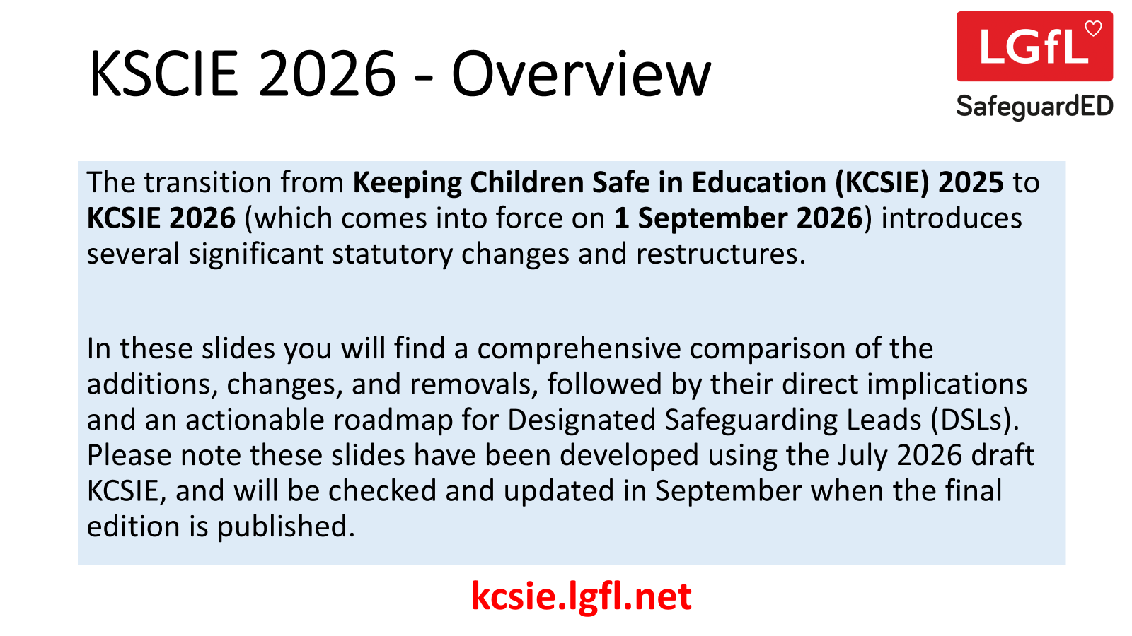

Slide 3
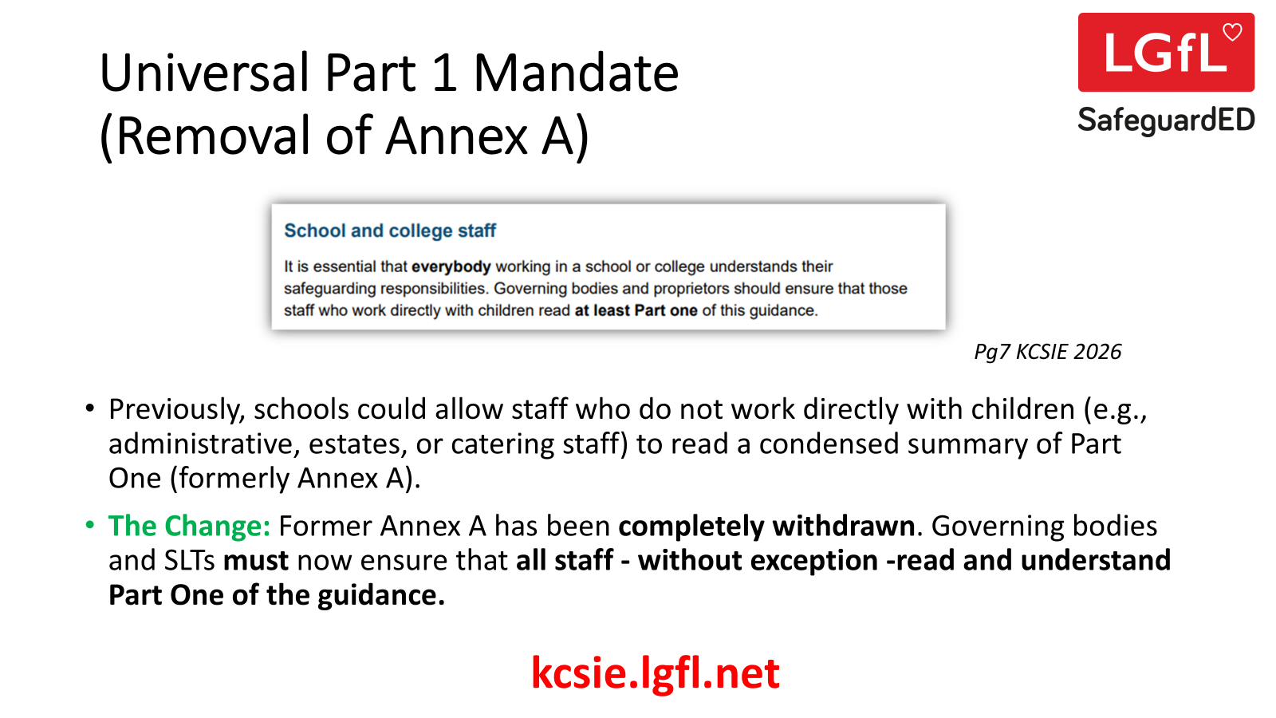

Slide 4
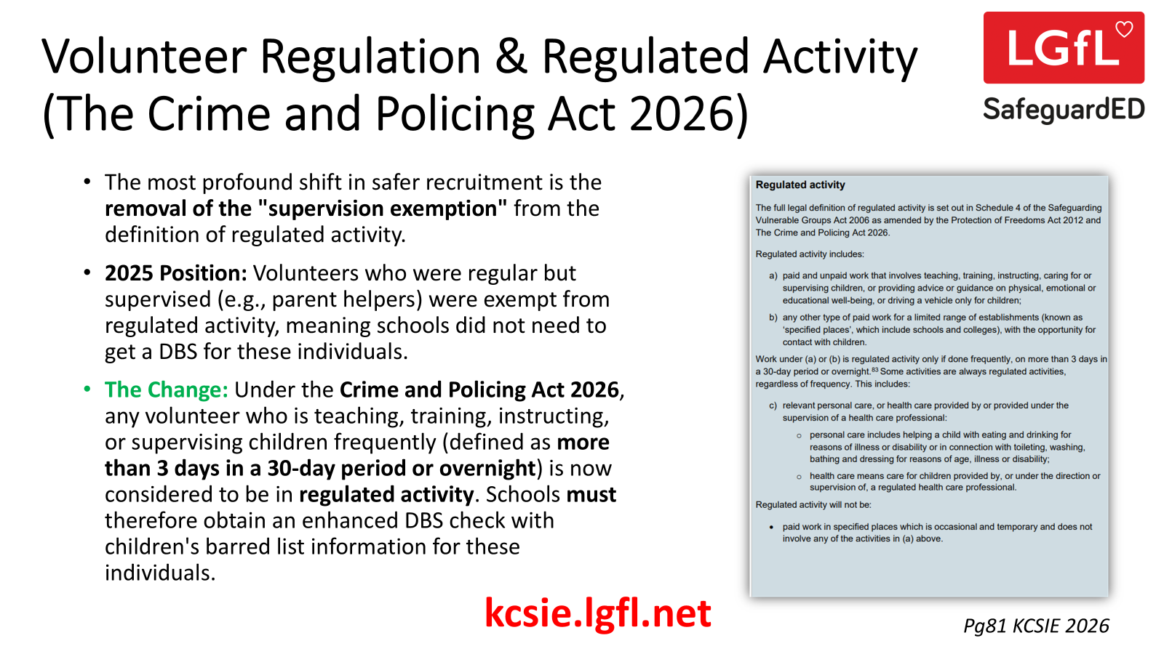

Slide 5
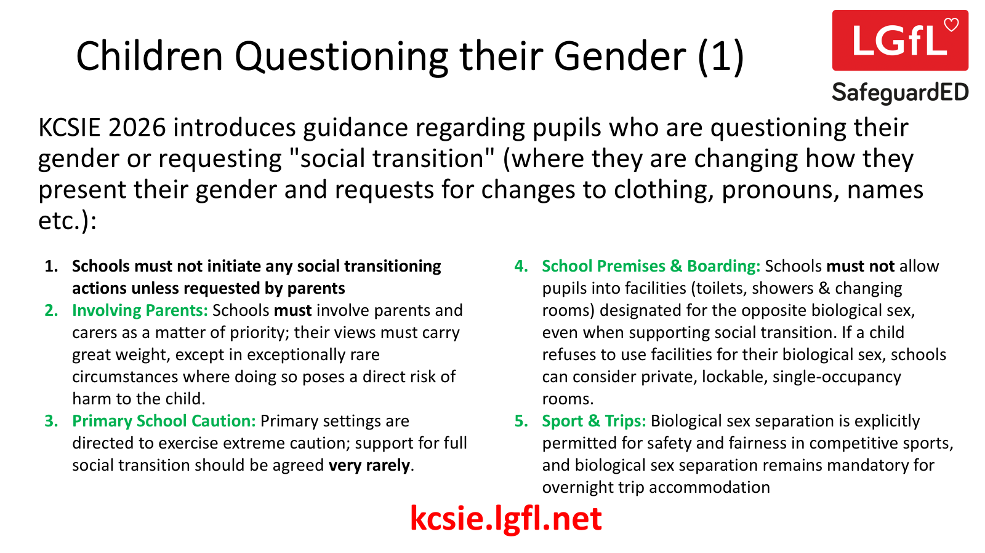

Slide 6
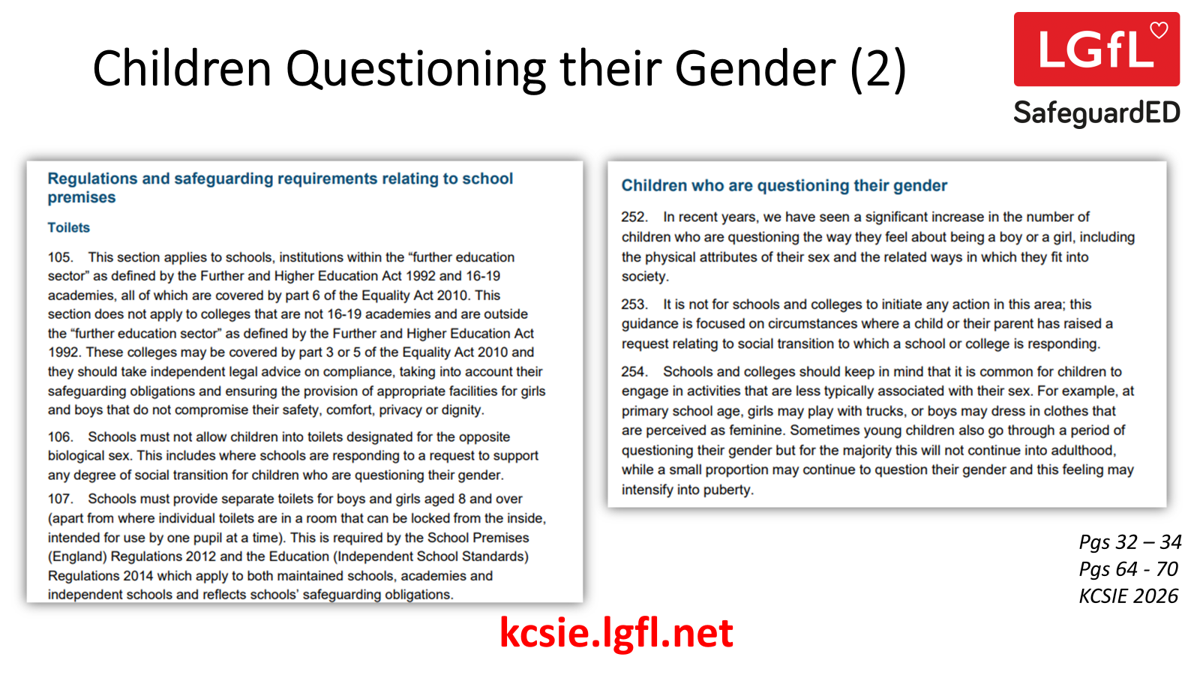

Slide 7
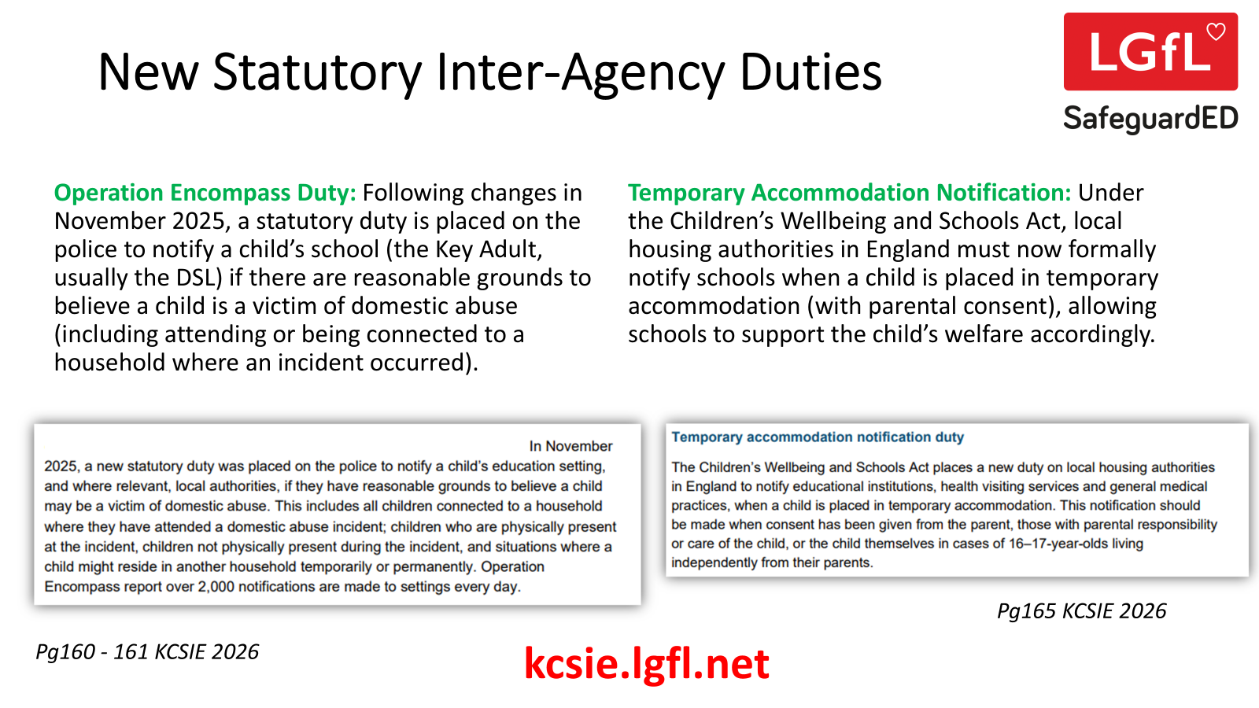

Slide 8
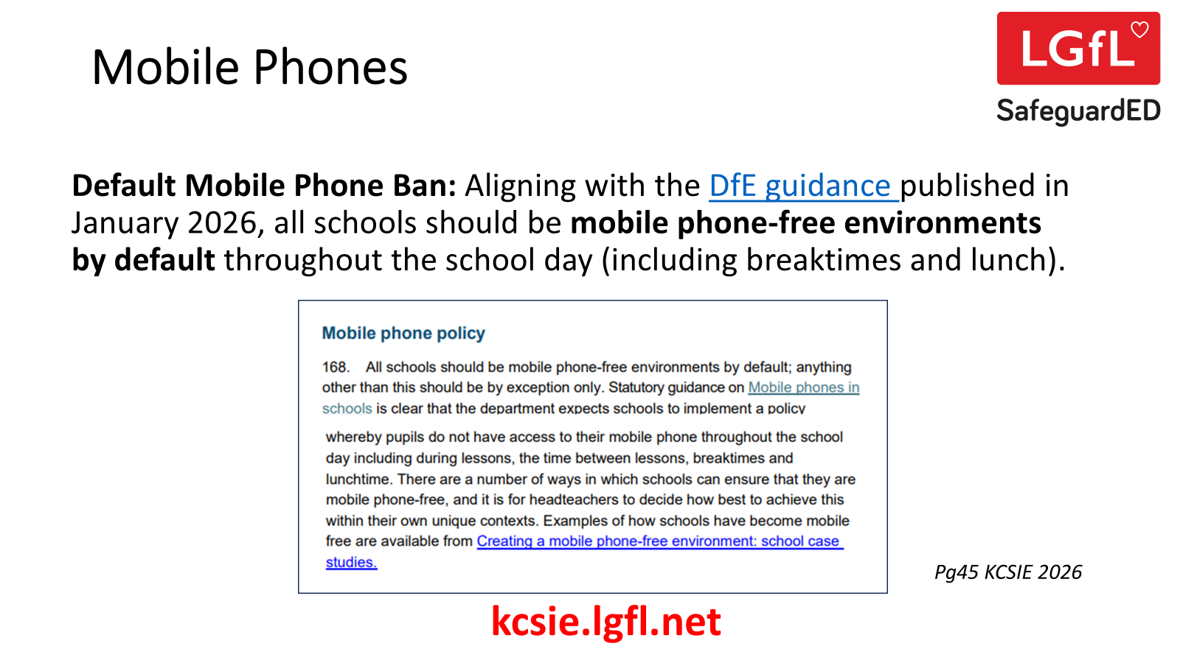

Slide 9
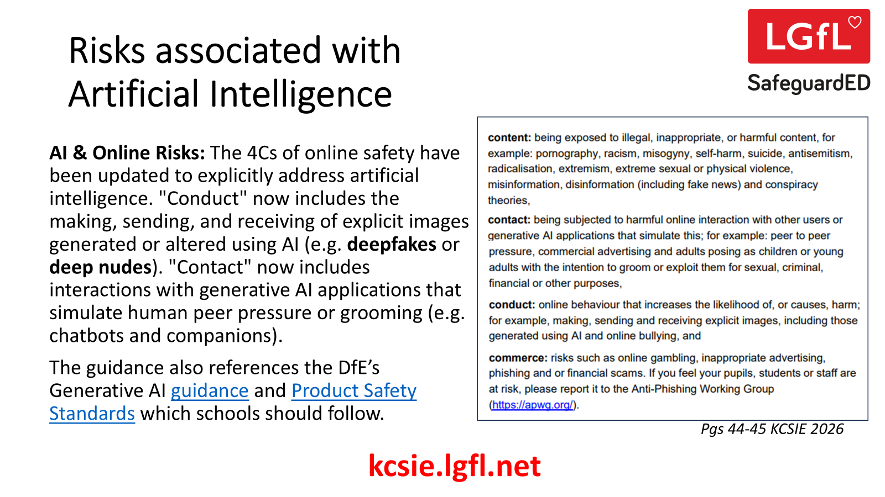

Slide 10
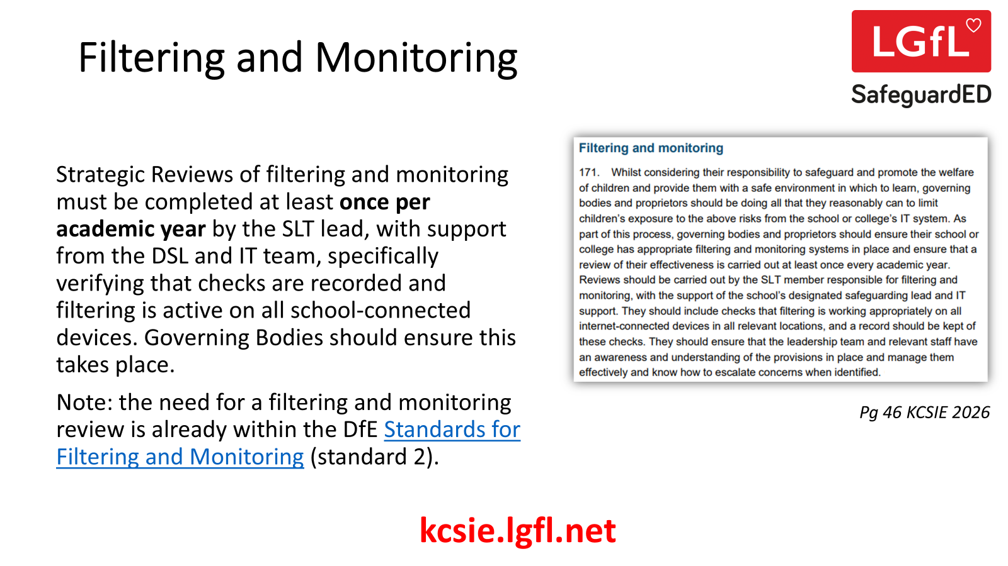

Slide 11
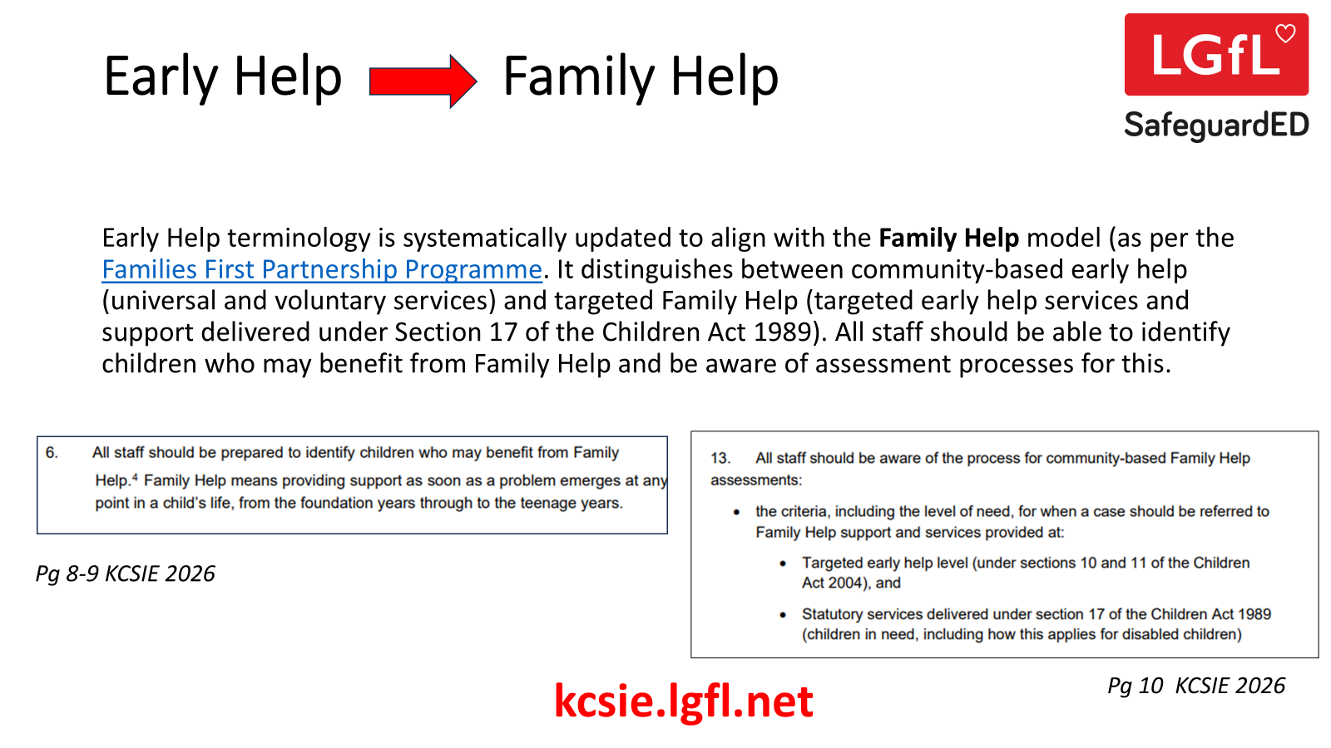

Slide 12
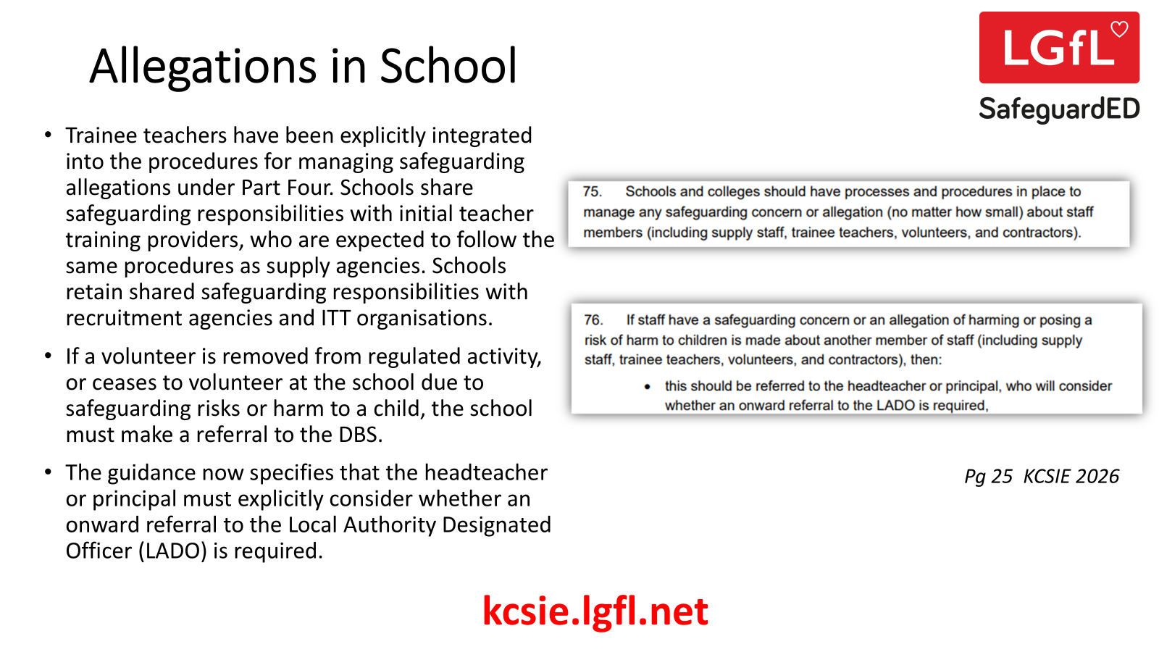

Slide 13
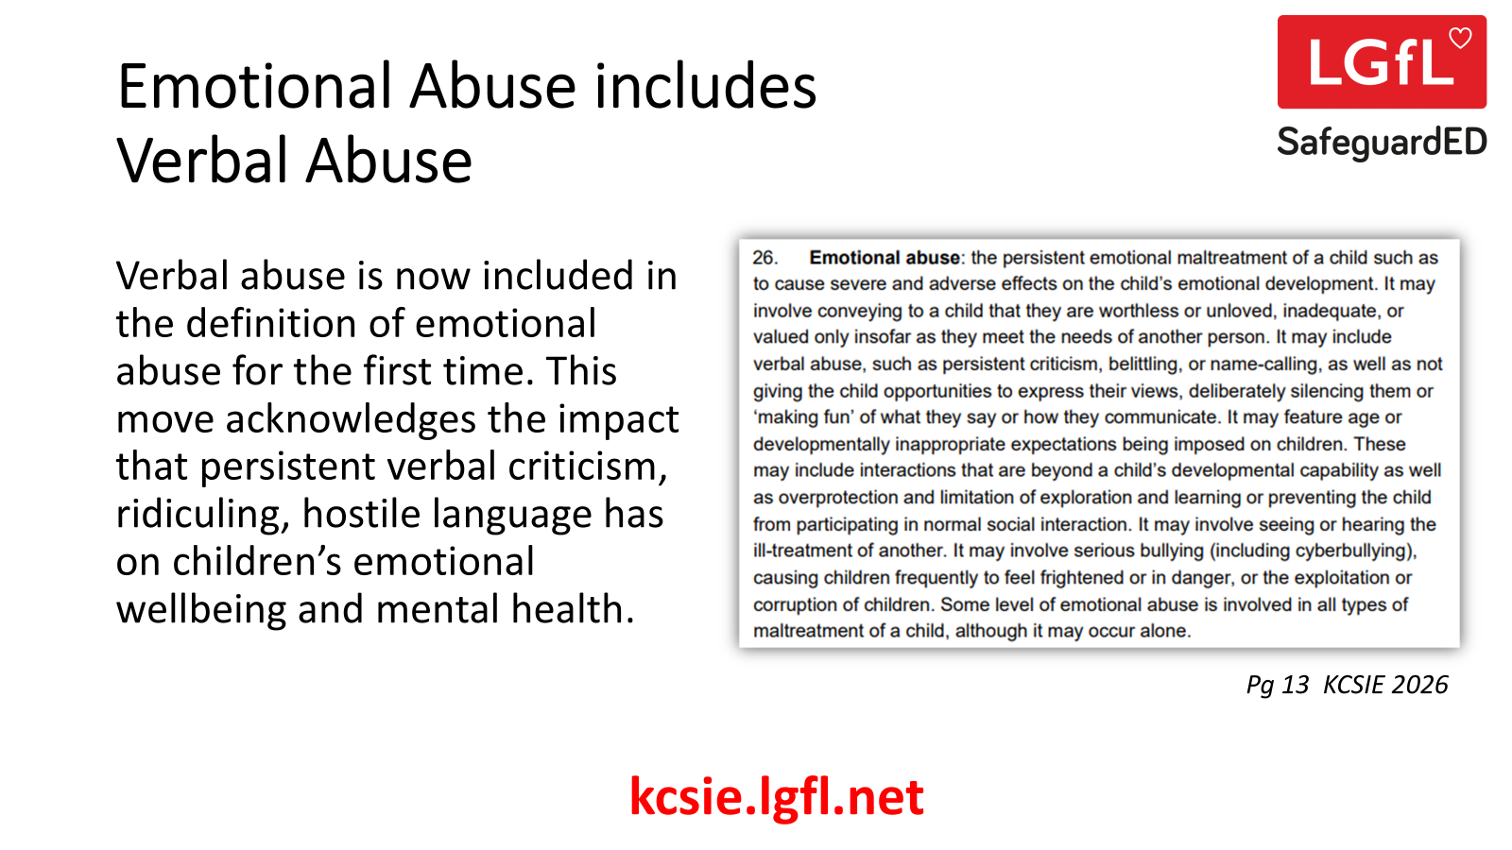

Slide 14
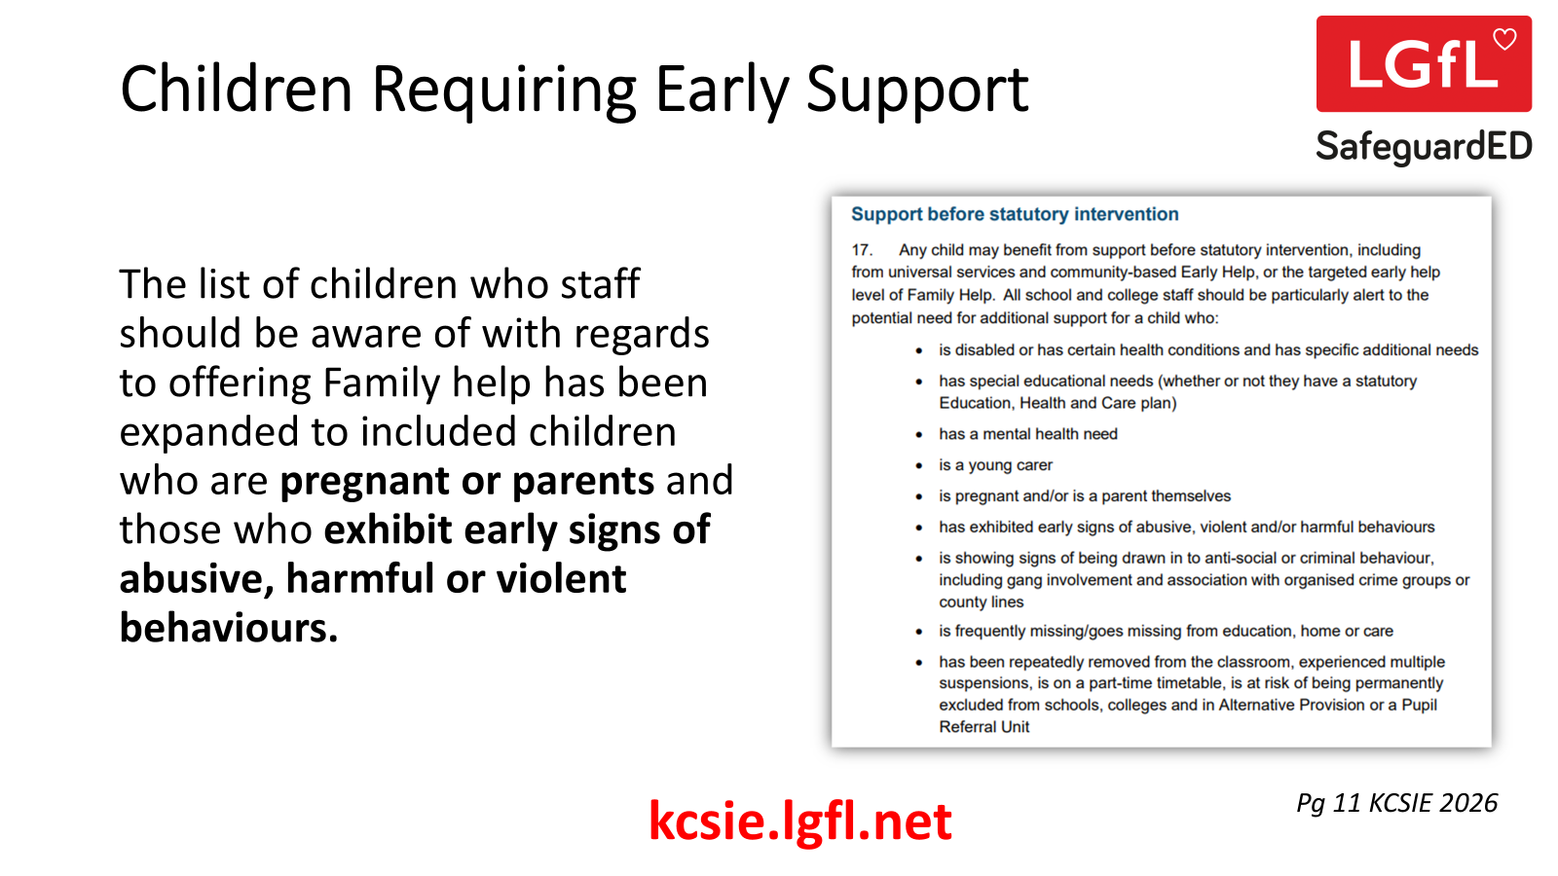

Slide 15
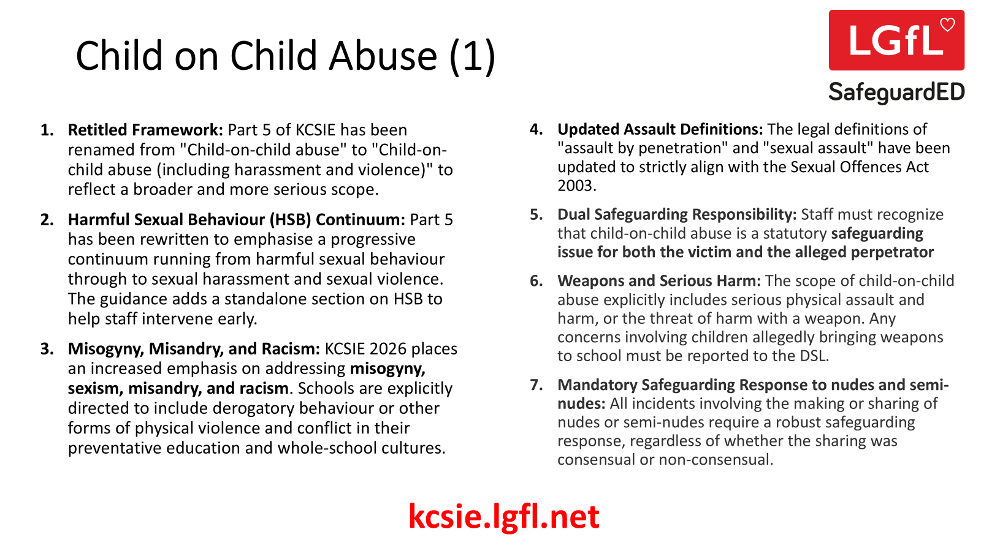

Slide 16
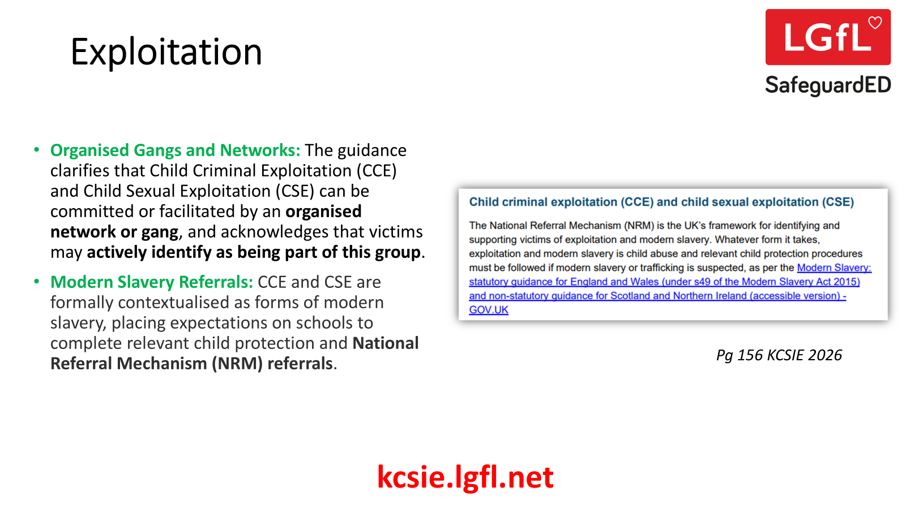

Slide 17

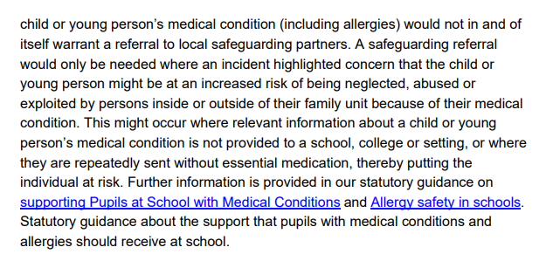
Children with Medical Conditions
A new paragraph has been included to state that incidents involving pupils with medical needs, including allergies, do not automatically require a safeguarding referral, whereas incidents as a result of neglect, abuse or exploitation of pupils would prompt a safeguarding referral.
Pgs 63-64 KCSIE 2026
kcsie.lgfl.net

Slide 18
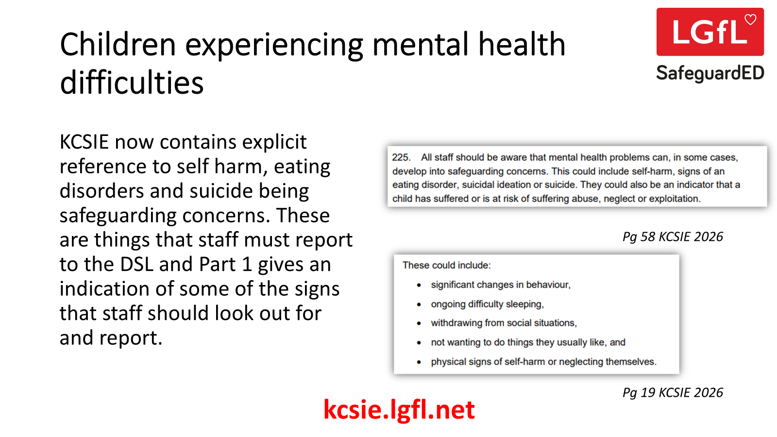

Slide 19
DSL Suggested Actions (1)
Conduct a Volunteer Audit: Identify any active volunteers who assist more than 3 days in a 30-day period or overnight. Initiate immediate applications for Enhanced DBS checks with children's barred list information before they resume duties on 1 September 2026.
Update All-Staff Training: Align your all staff training with the updates listed in this ppt. Remove all references to the Annex A. Issue the full Part 1 of KCSIE 2026 to all staff at induction and ensure you have evidence that they have read AND understood this. Our KCSIE Quizzes may help to demonstrate this. We also have free translations of Part 1 in 12 languages, for staff who may have English as an Additional Language.
Set up Robust Cover Arrangements: Establish a clear system for when the DSL is unavailable (due to illness or leave). Setting up a secure, confidential shared safeguarding mailbox is recommended to ensure no referrals or Operation Encompass alerts are missed.
Review School Premises: Assess your toilets, changing rooms, and overnight trip policies in line with the gender questioning guidance. Ensure strict biological-sex separation is enforced, and identify appropriate spaces for self-contained, single-occupancy facilities if individual alternative requests arise.
Ensure you have a robust and strategic approach to the use of AI: ANY use of AI by governors, staff, pupils or visitors should be as per your school’s policy and approach. Ensure you have a process for QA’ing and approving any Gen AI tools (including those that may already feature in existing curriculum resources and platforms used in the school e.g. Google search now has embedded Gen AI responses). Take a look at our free AI Policy Toolkit and supplementary resources to help.
kcsie.lgfl.net

Slide 20
DSL Suggested Actions (2)
Establish the Mobile Phone-Free Routine: Review and republish the school's mobile phone policy and share with parents and pupils. Consider the process for assessing exemptions such as children with medical conditions who require their phone, or young carers who may need to be contacted. Clarify your reporting process for staff if children are caught with phones, what are the processes and boundaries around searching and confiscating phones from pupils? What does your AUP and pupil behaviour policy say about mobile phones, are these aligned?
Verify Annual Filtering & Monitoring: Partner with SLT and your IT Lead to conduct, record, and sign off the mandatory annual review of the filtering and monitoring systems on all internet-connected devices in all locations (especially those that go off site). What will you use to complete your annual review? We have a free Online Safety Audit that can be used as the mechanism for this. How will you share with your governors? How do you complete and record your regular filtering checks? We have templates that you can download and use along with lots of other free resources including self service training for DSLs on safe filtering.
RSHE Review: Ensure your RSHE curriculum is updated, staff are trained and ready to deliver the new content as outlined in the RSHE Guidance and aligned in KCSIE.
Pastoral Support: Are your staff confident in recognising and responding to children who are experiencing self-harm, eating disorders and suicidal ideation? What support and resource may need to be given to achieve this?
Update your policies to account for these changes (e.g. Safeguarding, Online Safety, AUPs, Pupil Behaviour, Managing Allegations, Medical Conditions, RSHE etc.). LGfL have some template policies available to freely use.
kcsie.lgfl.net

Slide 21


LGfL Training to help
And much much more all available to book for FREE at…
safetraining.lgfl.net

Slide 22
Further Support
        Newsletter: newsletter.lgfl.net
        Blog: safeblog.lgfl.net
        Portal: safeguarded.lgfl.net
        Resources: saferesources.lgfl.net
        Training: safetraining.lgfl.net
        Email: safeguarding@lgfl.net
Socials: @lgflsafeguarded (X + FB + LinkedIn)

