Slide 1


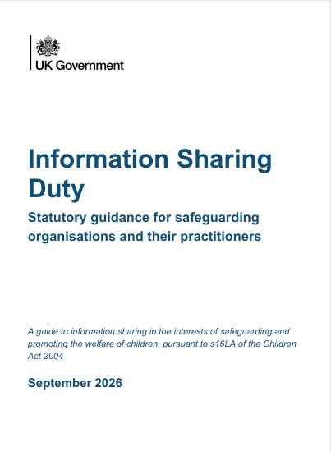
Information Sharing
Duty 2026
A Briefing for school leaders on the updated Information Sharing Guidance, 2026
https://www.gov.uk/government/publications/information-sharing-to-safeguard-children-and-young-people?utm_medium=email&utm_campaign=govuk-notifications-topic&utm_source=09edac8d-43d6-44f6-b818-e79fc3422e07&utm_content=daily
safeguarding.lgfl.net

Slide 2




The Shift to Statutory Duty
Comes into effect from 30 September
Legal Obligation
Regulatory & Inspection Focus
The guidance has been explicitly renamed as the Information Sharing Duty. This represents a formal transition from discretionary, non-statutory advice to a strict legal requirement under Section 16LA of the Children Act 2004 (via the Children’s Wellbeing and Schools Act). This impacts education settings as others such as the police, health and children’s services.
Because sharing safeguarding information is now a statutory duty, compliance will be assessed directly by regulators and inspectorates like Ofsted. Failure to share relevant info is no longer just a procedural lapse, but a breach of a statutory requirement.
safeguarding.lgfl.net

Slide 3
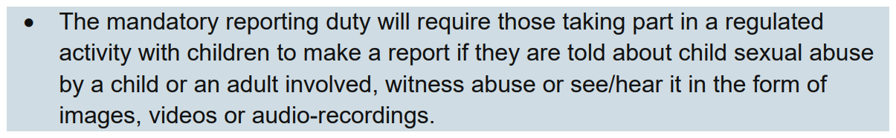
Mandatory Reporting of CSA
The Crime and Policing Act introduces a new statutory duty for individuals involved in regulated activity (which includes those working in schools) to report sexual abuse when they are made aware of it. It also includes a new criminal offence of attempting to prevent someone reporting child sexual abuse. Guidance and a clear implementation framework are still awaited at time of publication.
See safeblog.lgfl.net for an overview of the Crime and Policing Act and how it will impact schools.
safeguarding.lgfl.net

Slide 4


Lowering Barriers to Sharing
The "Must" Requirement: If you hold info relevant to safeguarding or promoting a child's welfare, you must share it with other relevant practitioners.
No Threshold Barriers: Sharing is explicitly required before formal statutory harm thresholds (such as Section 17 or Section 47 enquiries) are met.
Proactive Focus: The legal objective shifts away from defensive box-ticking and towards proactive, multi-agency disclosure to facilitate early intervention and prevent harm.
safeguarding.lgfl.net

Slide 5
Confidentiality & Consent
Previously, practitioners had to judge if sharing confidential information was legally justified, in the public interest, or required explicit parental consent. This created significant delay and friction between agencies who are duty bound.
The updated 2026 duty creates an unambiguous legal requirement to share information relevant to safeguarding and child welfare. This overrides the Common Law Duty of Confidentiality, enabling faster, more consistent multi-agency action.
safeguarding.lgfl.net

Slide 6






The Three Decision Tests
In order to decide whether to share information, you must decide:
1. Relevance
2. May Facilitate
3. Detriment
Does the information have a direct bearing on safeguarding or promoting the child’s welfare? If information was requested from you, do you have sufficient context to confirm this relevance?
Could sharing this information reasonably help the recipient safeguard the child or assess risk? Is the receiving partner covered under the list of 'relevant persons' within the duty?
Could sharing be of greater detriment to the child than not sharing? Are there any clear mitigating actions that can be taken to safely share anyway rather than blocking disclosure?
2. May Facilitate
safeguarding.lgfl.net

Slide 7
Scope & Detriment Exception
The Detriment Limitation: A very narrow exception exists if sharing would be more harmful (e.g. putting the child in immediate physical danger or directly compromising a live police operation).
Mitigation Framework: Professionals should not just refuse to share. They must actively explore safety mitigations so that crucial information can still be securely shared.
Holistic & Contextual Risk: The duty mandates sharing when a child poses a risk to others. It also covers sharing context on connected peers or adults that impact parenting or welfare.
safeguarding.lgfl.net

Slide 8
Routine Strategic Data Sharing
Local Partner Agreements: Safeguarding partners (within your Local Safeguarding Children Partnership) can officially agree that schools must regularly and routinely share data.
Routine Metrics Target: This mandates the systematic, ongoing sharing of non-acute indicators such as attendance patterns, exclusions, and absence rates to identify patterns of emerging harm early.
Multi-Agency Systems: The guidance strongly encourages moving away from isolated databases and toward shared multi-agency IT systems to coordinate responses seamlessly.
safeguarding.lgfl.net

Slide 9


Operational Reflections
System Dynamics
Relational Dynamics
Admin Load: How will we handle routine attendance sharing without overburdening staff?
Parent Trust: How do we preserve parental trust and partnerships when legally forced to share data they might strongly object to?
System Responsibility: Who covers the cost and security of shared IT systems? How do we coordinate across multiple local authority boundaries?
Voluntary Gaps: Voluntary and private providers are excluded from this legal duty. How will schools piece together a holistic view if partners aren't legally bound to share?
Age Limits: This statutory duty applies only to children. How do we manage safeguarding disclosures for our 18-year-old students?
safeguarding.lgfl.net

Slide 10




Action Plan for Leaders
Comes into effect from 30 September
2. Policy Audit
4. Relationships
Update Safeguarding Policies, Data Protection Policies, Data Sharing Agreements (DSAs), and Privacy Notices to reflect the new statutory duty.
Strengthen parent communication structures by adopting relational oractice (relationalpractice.lgfl.net) to support transparent engagement.
1. Oversight
3. Staff Training
Ensure DSLs keep robust records documenting decision-making for both sharing and non-sharing under the three tests to demonstrate compliance to Ofsted.
Train all school staff on the new sharing requirements and decision frameworks, establishing robust lines of support through the DSL and DPO. This should include the importance of reporting early signs and indicators of harm and a secure understanding of cumulative harm
safeguarding.lgfl.net

